Slide 1

EVALUATION OF CENTRALLY SPONSORED SCHEME ON TEACHER EDUCATION IN STATES/UTs
A Draft Report
TATA INSTITUTE OF SOCIAL SCIENCES Mumbai
25 September 2017

Slide 2
This Evaluation Study
Presents a comprehensive picture of CSSTE implementation across the country (survey in 13 States and UTs).
Covered 91 institutions, 500 functionaries, 12 SCERT Directors, and
7 Secretaries of Education
Identifies the extent to which the stated objectives and targets have been met in CSSTE Guideline 2012,
Identifies the factors that have helped achievement of the objectives, and
Addresses challenges and constraints that have affected the intended course of implementation.

Slide 3
Data gathered from
Field work in 11 States / 2 UTs,
Available reports, minutes and MIS data of the programme by the state and the central governments,
Sampled SCERTs/ DIETs/ IASE/ CTEs, and
Interactions with DRT/SSA/RMSA head, Education Secretaries
The study provides recommendations about areas that need to be revised and strengthened under CSSTE; can serve as an important ingredient for evidence based policy formulation and reform.

Slide 4
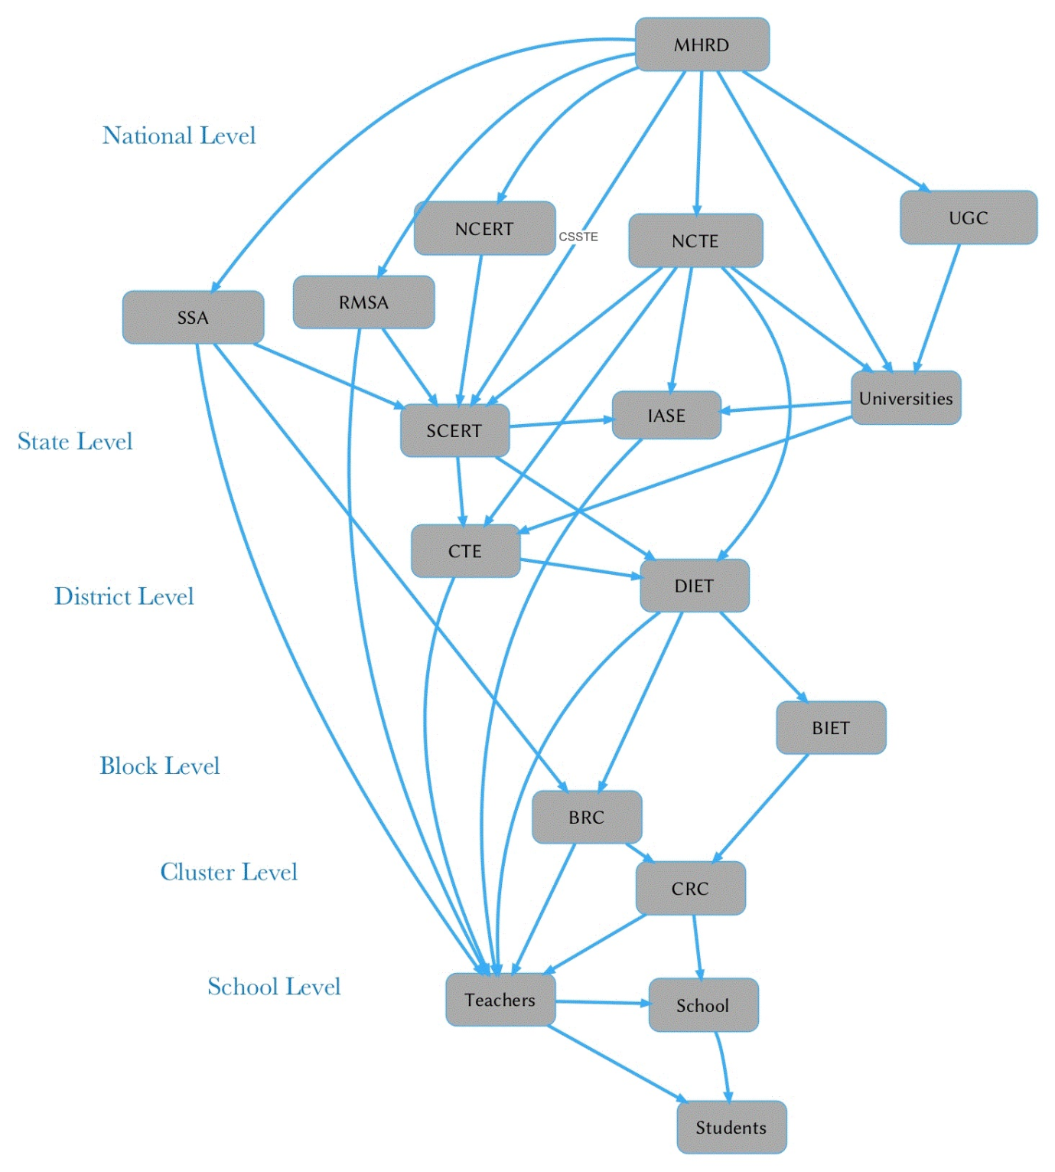
Teacher Education Organogram

Slide 5
Evaluation questions and indicators for the study
Research Questions | Indicators
Has there been an improvement in Pre-Service Teacher Education and has it contributed towards overall improvement of teacher professional development and school improvement? | Quality of Teachers Education Program, Curricular revision Classroom transaction Facility at pre-service institution Faculties and expertise
Has there been an improvement in In-Service Teacher Education and has it contributed towards overall improvement of teacher professional development and school improvement? | Quality of training module Quality of transaction Follow up process
Has there been development of professionalism and capacity of Teacher Educators? | Process and mechanism to prepare teacher educators in system Activities to prepare teachers educators Materials / Module for teachers educators

Slide 6
Have strong inter-linkages developed within Teacher education and training sector between the following: Existing Departments and Institutions at district level Existing Departments and Institutions at state level Higher Education Institutions Schools Non-Government Organizations | Nature of activities to ensure convergence among state level Nature of activities to ensure convergence among district and sub district level
Have institutions at all levels led to the adequate supply and quality of trained teachers at elementary and secondary levels of education? | Percentage of trained teachers in system
Is there in place processes, systems and structures across institutions to ensure planning, monitoring and tracking? | Process of planning Mechanism for Monitoring
Has there been an adherence to guidelines related to staffing? | Vacancy
Has there been an adherence to guidelines related to the infrastructure? | Improved infrastructure in Institute

Slide 7
Has there been an adherence to guidelines related to the flow of funds? | Timely fund flow
Has there been use of ICT to enhance institutional, instructional and teaching quality across the institutions? | Nature and quality of teachers training for ICT No. of program in ICT Materials developed in ICT
To what extent has the academic profile of the institutions been strengthened through the following: - Research and Publication - Education Courses for Faculty - Seminars - Workshops - Study Tours | Nature of publication Quality of courses for faculty Quality of seminar Quality of study

Slide 8
Has the flow of funds affected the quality of implementation of the scheme? | Fund flow mechanism Expenditure per quarter
Has there been scope for operational autonomy for institutions under the scheme? Has there been scope for various actors and institutions to adapt the guidelines and requirements to meet local needs of quality and adequacy? | Innovative use of support available under CSSTE

Slide 9
Summary of tools employed
Tool No. | Tool Name | Respondent | Details
Tool 1 | Interview Schedule for State Coordinators of TE | State level TE functionaries | Contains all basic information of state’s teachers education progress, fund flow, coordination, annual plan and monitoring of CSSTE for all years pertinent to the study
Tool 2 | Key Informant Interview Schedule | State Education Secretary, SCERT Director | Gathers perceptions, views, insights, experience and contextual scenario of the state
Tool 3 | Focus Group Discussion Guide | SCERT faculty | Data on activities under CSSTE - includes training, materials development, capacity building, research etc . and their role in TE

Slide 10
Tool 4 | Interview Schedule for Head of Institutions | Interview of Institution Head | Perception and view about
Tool 5 | Institutional fact sheet | To be filled with help of Principals of DIETs/ BITEs /CTEs /IASE | Collects all basic information of selected institutions and their functioning covered under evaluation study
Tool 6 A | Faculty Interview Schedule (I) | DIET/BITE/CTE faculty (1 per institution) | Gathers perception, views, experiences, insights into role, challenges and recommendations
Tool 6 B | Faculty Interview Schedule (I) | IASE faculty (1 per institution) | Gathers perception, views, experiences, insights into role, challenges and recommendations
Tool 7 | Student-Teacher Interview Schedule (I) | Student-teachers from the DIET/BITE/CTE / IASE | Gathers perception, views, experiences, insights, challenges and recommendations
Tool 8 | Observation Protocol (I) | DIET/BITE/CTE/IASE | Captures the infrastructure, activities, processes, ethos of the institution

Slide 11
Sampling
Sr. No. | Zones | Sample States/UTs visited | Minimum number of institutions visited
1. | East Zone | Bihar, Assam, Chhattisgarh, Mizoram | SCERT - 1 IASE - 1 CTEs - 2 DIETs - 4 BITE - 1
2. | West Zone | Maharashtra, Madhya Pradesh, Rajasthan
3. | North Zone | Delhi, Himachal Pradesh and Uttar Pradesh
4. | South Zone | Telangana, Karnataka, Puducherry

Slide 12
Limitations
Study is based on fieldwork undertaken at selected sample institutions and secondary reports and documentary proof maintained by government functionaries at various levels.
Study has not been able to examine the content analysis / academic qualities of the materials produced at different levels due to the short duration of the study.
Analysis has been presented with respect to norms, objectives and provisions under CSSTE and with a focus on post-2012 period.

Slide 13
Findings and Recommendations

Slide 14
Key concerns emerged ...
Quality
Convergence
Fund flow

Slide 15
SCERT - major function envisaged and implemented
Academic authority
Development of curriculum, Syllabus & textbook: all the states under survey have reformed curriculum
Pre Service: Reform D.Ed Curriculum but not B.Ed
Organization of in-service education
Extension programs for all categories of educational personnel.
Research and survey
Certification program on teachers’ education for untrained teachers, as in cases of Assam, Uttar Pradesh, Bihar & Chhattisgarh.

Slide 16
SCERT - Vacancy
Far away from - visualization UNDER CSSTE
Vacancy against sanction post : range from 10% (CG) to 80% (Assam)
No of position range from 16 (Assam ) to 46 ( Maharastra ) ( Bihar data not available )
Analysis: Not recruiting faculty is not a cost effective way
https://docs.google.com/document/d/1-WlcsHWE7ylXDpVxJYRhcWqPhNhrdMm-eUYHPFd5Xgw/edit

Slide 17
Faculty support system
Each SCERT has its own library. While most of the libraries have a good number of titles, which are mostly textbooks and reference books, very few new titles have been added recently.
SCERT provided laptop to select faculty and functionaries on a case to case basis.
Weak data base: A structured admin support is unavailable for regular supply of data for micro planning, Delhi, Karnataka and CG have rich website, others need to be adequately improved
Capacity Building : Selected faculty get chance - TSG, NCERT , Arizona University , TESS (Teacher Education through School-based Support )

Slide 18
Planning process
Each SCERT has their own process and steps for planning and also demands input from district level institutions, it essentially appears very centralized and norm driven rather than being geared for addressing the issues and needs of the state.
Role of District is limited to execution
Planning of teacher education is mostly dependent on a few individuals at SCERT- Institutional Mechanism
Critical role of TSG to orient states / UTs planning process: Good if TSG can participate at states level meeting/ workshop / seminar

Slide 19
Concerns
Quality of activities
Gross absence of third party evaluation / vetting
In house capability
No convergence: to some extent MHRD norms are also responsible
Expertise and Discourse

Slide 20
IASE
There is a variation in terms of resource allocation, infrastructure availability and functioning of IASEs in India. While a few IASEs are better resourced and executing their roles as “regional resource centres” and “academic mentors” to other stakeholders, there are IASEs which are waiting for both academic and non-academic posts or struggling due to lack of funds.
A lack of synergy was noticed in most states due to the presence of two different academic heads which lead to non-consultation on training requirements and duplication of trainings.

Slide 21
IASE, contd...
Areas of improvement can be focussed on systematic and effective leverage of ICT in the routine functioning of IASEs and not just limited to use of classroom presentations and admission processes.
Similarly, research work only leading to use of action research as a methodology needs to be discussed and thought about.
Major focus and emphasis is required towards well planned research studies conducted by faculty-members which are qualitatively effective than research conducted just for the sake of doing them.
Annual conferences for teacher educators and the larger teacher community can provide a platform for further deliberation.

Slide 22
CTE
A clear demarcation of academic and administrative responsibilities taken up by the faculty at CTEs is currently missing. A proportionate distribution of workload would help in enhancing the productivity of these institutions.
The CTEs find it difficult to prioritise their various roles in the education sector. A ranking of necessary activities to be performed by individual institutes and its faculty based on local context and need is necessary.
Granting academic autonomy can aid many of these institutes in bettering their current performance.

Slide 23
CTE-contd...
Interconnectivity between different CTEs is currently lacking. Harnessing the potential of technology to establish this connection between CTEs across the country will greatly aid cross-pollination of idea, abilities and expertise.
A training management system both at the institute and the state level will enable better load sharing and easier dissemination of knowledge by tracing and tracking teachers who need to attend faculty development programs.
There is a need to better regulate fund flow and infrastructure development to support the activities of the CTEs.
Performance based incentives can be implemented with greater rigour to encourage and motivate capable faculty to contribute to teacher education and nation building.

Slide 24
DIETs
Greater awareness needs to be built among the faculty at DIETs regarding their academic and administrative responsibilities.
Like the CTEs, a prioritisation of tasks is required at, equally, the academic and administrative levels for a more efficient work distribution and functioning of the institutes.
Greater academic and financial autonomy can help the DIETs address the specific needs of their local communities more effectively. This pertains to administrative and pedagogic roles in the education ecosystem.
An interconnection between DIETs can help cross-pollination of ideas, research and collaborative studies on best practices. It will also enable sharing of responsibilities at the level of materials design and curriculum development by creating communities of practice.

Slide 25
DIETs
A centralised training management system will aid in further cementing collaborations between the different DIETs in the state, not simply through faculty exchange and exposure visits but also by harnessing the affordances of technology to trace and track the needs of teachers in schools and address them effectively.
A more transparent, regulated and timely flow of funds is desirable.
Performance based incentives when introduced with greater rigour can act as motivating factors for faculty to deliver efficiently and effectively in their duties.
Encadrement of teacher educators is necessary.
There is a need to view courses in elementary education as professionally viable degrees. It was suggested at some DIETs that the course be renamed as Bachelor in Elementary Education, which can cause a change in expectations of faculty and students and cause greater number of registrants.

Slide 26
BITEs
Good start to address regional / local requirements: The BITEs have been envisaged as a powerful medium to reach the goal of quality and contextually relevant elementary education by ensuring the participation of local youth in the teaching profession.
Shortage of faculty, inadequate infrastructure and other facilities (e.g. a well equipped library or lab) that arise from the lack of adequate and timely funding. This adversely affects the quality of teaching learning offered in the institution.
The TEAB minutes of the states over the past five years (2012-17) reveal administrative logjams and financial roadblocks that have led to several revisions and re-examining of the sanctioning of the proposed BITEs.

Slide 27
Teachers Professional Development
Notion of quality: Pre-service
Link of Pre-service and In-service
Convergence of all scheme - SSA, RMSA & CSSTE - Government of India has three different schemes for supporting school education and teachers’ education, namely, SSA, RMSA and CSSTE. All three schemes have significant components for in-service teacher education whereas CSSTE has pre-service component as well.
Mechanism for In-service - Modalities of in-service training is grossly dependent on the structure of policy and scheme under which these trainings are usually funded and conducted within the state structures.

Slide 28
Use of Technology
“Imagine a set of surgeons and school teachers, from lets say a hundred years back, travel to the current age. The surgeons from the bygone era would be mostly unable to determine what was happening and what the devices are in a modern operation room. This is because there has been a mega-change in the field of medicine by use of technology. Contrast to this the school teachers from the bygone era would be perfectly in tune, barring some strange devices in the classroom, regarding what was being taught and might be even able to take over the teaching in the class.”
The Children’s Machine: Rethinking Education in the Age of Computers,
Seymour Papert (1991).
With this parable Papert asks the question: Why, through a period when so much human activity has been revolutionised (by use of computers) have we not seen comparable change in the way we help our children learn? (p. 2)

Slide 29
Nature of Technology Use across TEIs
Use of technology limited to that of an infrastructural resource and not beyond (right now it’s limited to digital literacy)
Not leveraged to its full potential as an aid, for example, a few TEIs are maintaining TMS (e.g., DIET Serchhip, MZ); conducting multi-modal B.Ed course (IASE, Aizawl, MZ); making TLMs (DIETs in Ujjain, Bikram (Patna), Nalanda)

Slide 30
Recommendation
Continuation of CSSTE Scheme - only hope for quality
All teachers training should merge with CSSTE; through SCERT, IASE, CTEs, DIETs, BITEs
Convergence of all stakeholders on a single platform - no two heads/authorities
Selected DIETs in every state be upgraded to take up secondary teacher education
Replace D.El.Ed/D.Ed by B.Ed (Level 1)

Slide 31
Thanks !

