Slide 1
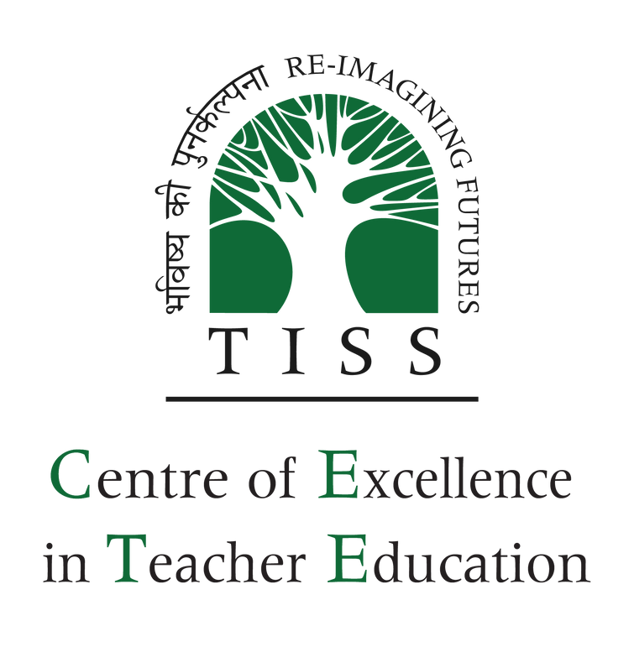


Strengthening DIETs: The Case of Uttar Pradesh
Authored by: Dr. Bindu Thirumalai

Slide 2
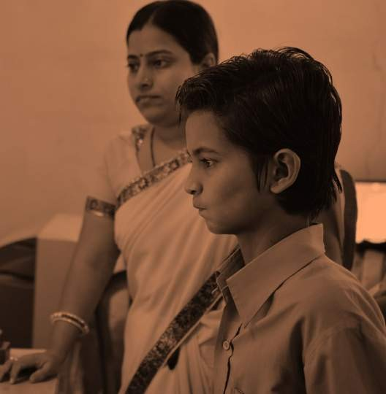

CENTRE OF EXCELLENCE IN TEACHER EDUCATION
Centre of Excellence in Teacher Education (CETE) at Tata Institute of
Social Sciences (TISS) aims to create lasting impact in India’s education sector by professional development of teachers of schools across the nation.
Supported by TATA Trusts as a Founding Partner, it envisions a nodal institution for teacher training and development that can set standards of teacher professional development in the country. It will work closely with state and private teacher education institutions to scale and mainstream impact on teacher development.
Introduction to CETE: hhttps://www.youtube.com/watch?v=UABm3RyVXYAttps://wwe.com/watch?v=UABm3RyVXYA
8

Slide 3
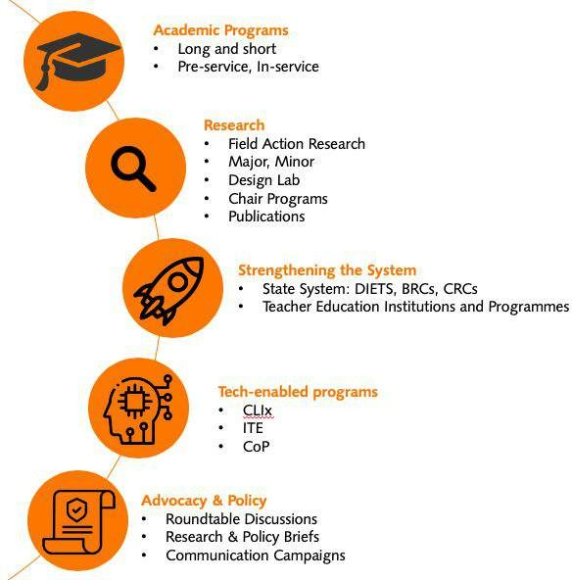
CETE: Focus Areas
Academic programs to improve quality of teacher education through
on-campus, blended and online modes for both pre-service and in-service teacher development
Research to develop knowledge and understanding of education and its dimensions - society, curriculum, pedagogy, teacher learning and policy
Strengthening existing state and private systems of teacher education – building capabilities of state functionaries and teacher educators
Demonstration for ICT based initiatives to facilitate 21st century skills
Advocacy & impacting policy by mobilizing other stakeholders to invest, inform and strengthen the ecosystem of teacher education in the country
14

Slide 4
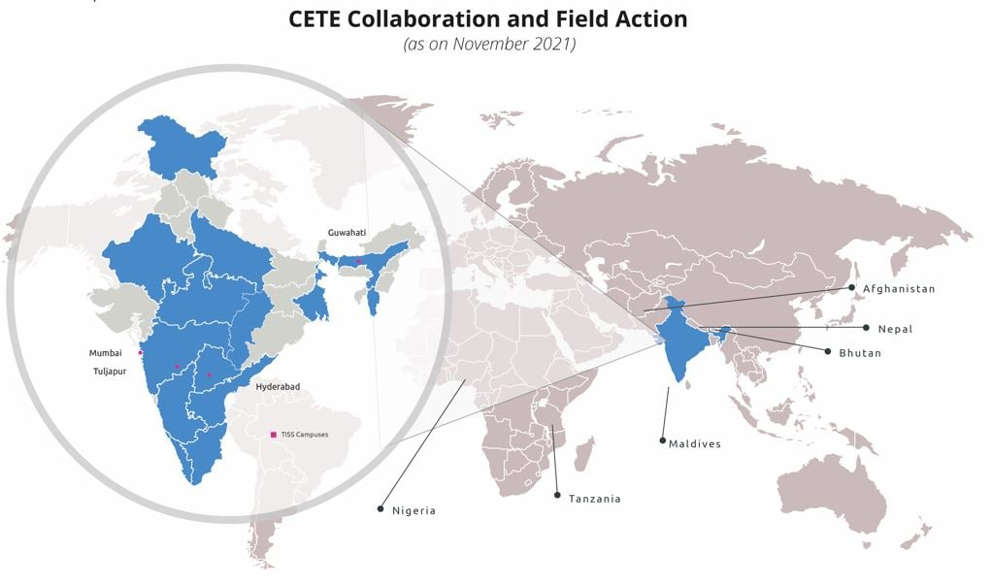
Our Geographic Footprint

Slide 5
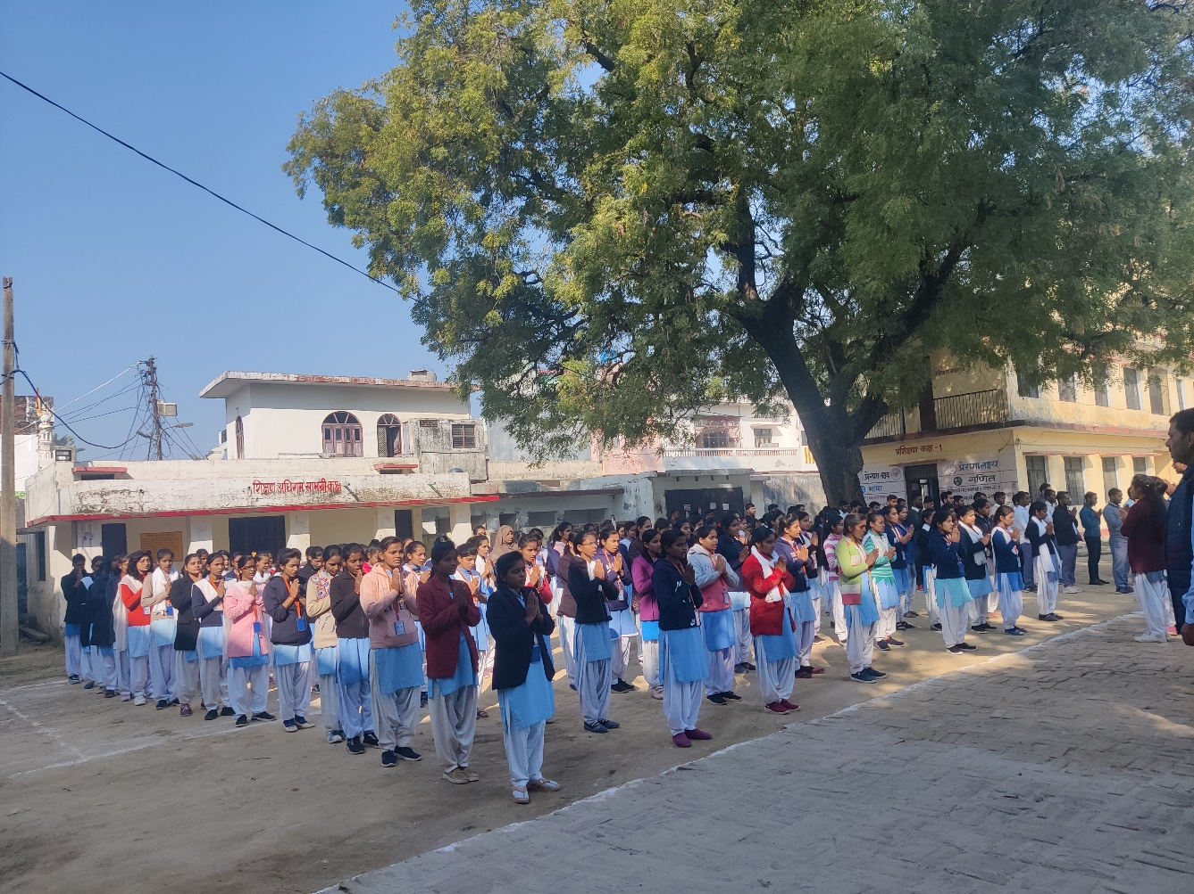
Design, adoption and implementation of the existing (revised) pre-service curriculum to inform further curricular and pedagogical reform
Design and implementation of teacher professional development programmes to understand the successes, gaps and opportunities for implementing blended and online professional development of teachers
Teaching and learning and adopting active and experiential pedagogical practices and developing student’s 21st-century skills
The functioning of DIETS as key institutes for academic development and support of teachers at the district level
OBJECTIVES

Slide 6
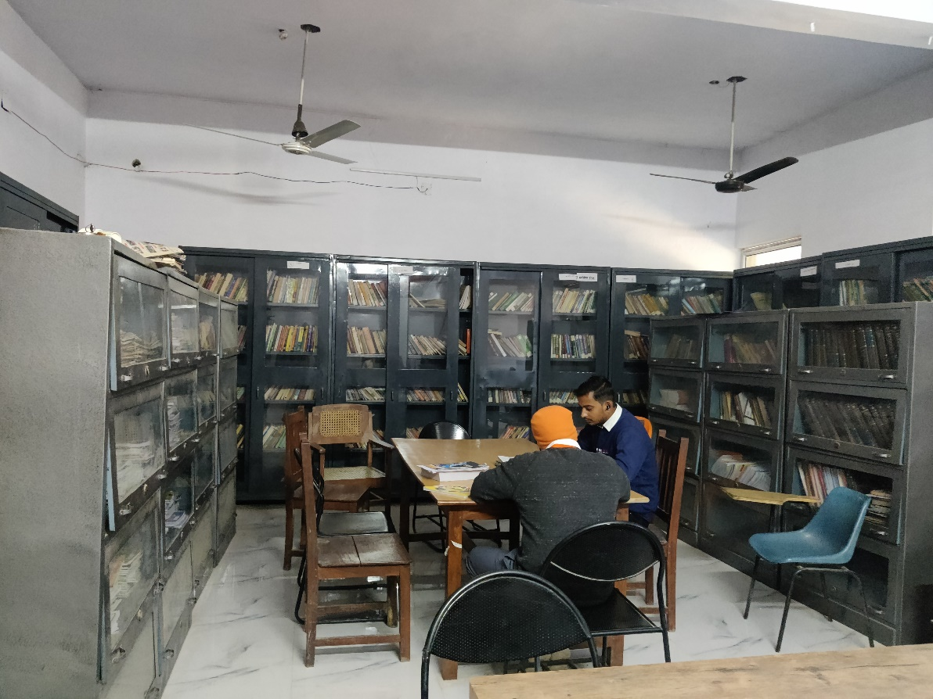
What are the highlights and gaps of the existing D.El.Ed curriculum
vis-à-vis research-based teacher education models, NCFTE 2009 framework and the recommendations of the NEP 2020?
RESEARCH
QUESTIONS
How efficient and effective are teacher development processes and implementation (pre-service and in-service) programmes and other DIET activities undertaken in the DIETs?
What are the availability, utilisation and needs of physical resources and staffing (faculty and staff) of DIETs?
What gaps must be filled for DIETs to be developed and function as Centres of Excellence in Teacher Education?

Slide 7
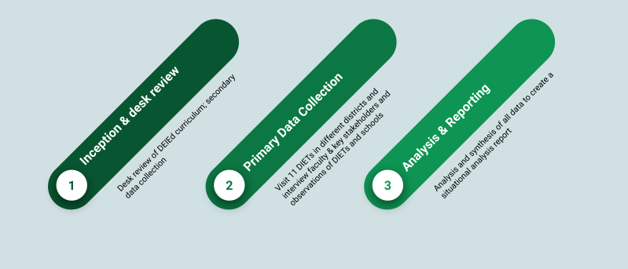
METHODOLOGY

Slide 8
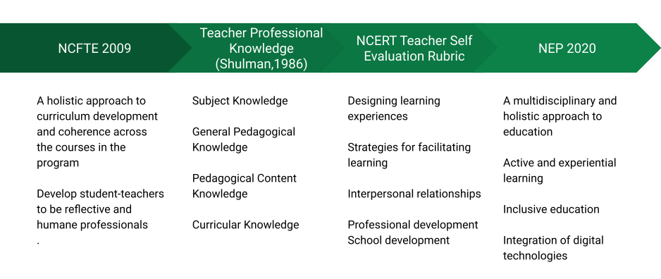
METHODOLOGY
Curriculum Review
Framework

Slide 9
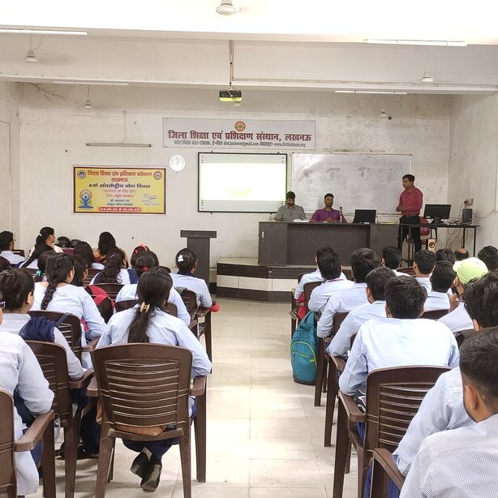
  A strong thrust towards developing teachers as reflective, humane and autonomous practitioners who can address social justice concerns (GoI, 2020, NCTE, 2009)
  The development of teachers’ Pedagogical Content Knowledge (PCK) and the introduction of teachers to research-based PCK in the various subject domains especially for upper primary teaching (UNESCO, 2021)
  Addressing latest trends and research in theory and practice related to inclusive, IC﻿T and gender education (GoI, 2020)
CURRICULAR
IMPROVEMENTS
NEEDED

Slide 10
  Opportunities for self and professional practice skills to address prospectiv﻿e teachers' deep-rooted beliefs & attitudes towards learners & learning to be effective professionals (NCTE, 2009, NCERT, 2013)
  A robust internship programme to enable linkages between theory and practice (NCTE, 2009)
CURRICULAR
IMPROVEMENTS
NEEDED

Slide 11
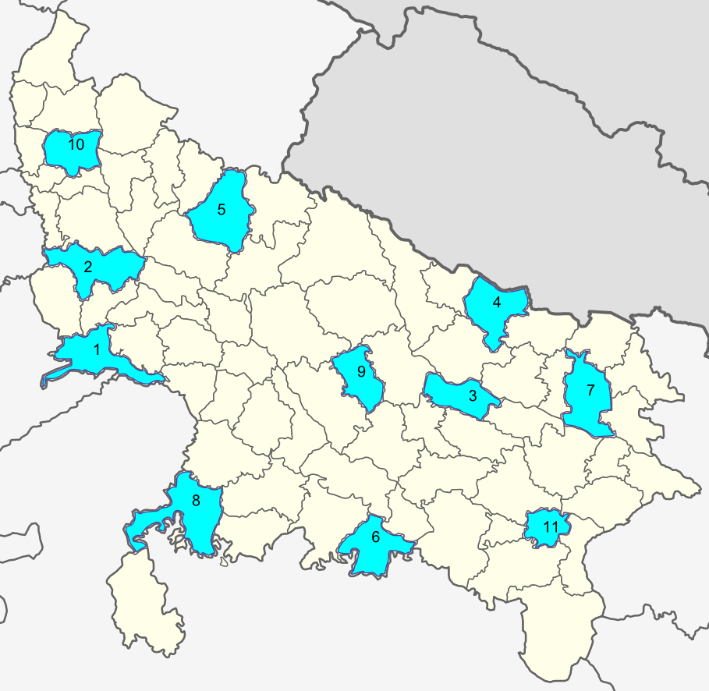
70 DIETs in UP
DIET FACT SHEET
  70 DIETs Submitted data - faculty profile, pre-service enrolments and activities, in-service participation and activities, innovations and infrastructure
Field Visits to 11 DIETs
  Agra
  Aligarh,
  Ayodhya,
  Balrampur
  Bareilly
  Chitrakoot
  Gorakhpur
  Jhansi
  Lucknow
  Meerut
  Varanasi
METHODOLOGY
Primary Data Collection

Slide 12
Institutional Identity and Focus
Systemic location and relation to other institutions
Financial Aspects
Development of Faculty and Staff
METHODOLOGY
Data Analysis Framework
DIET Function and Activities
Collaborations and Partnerships
Infrastructure
Impact of Covid-19

Slide 13
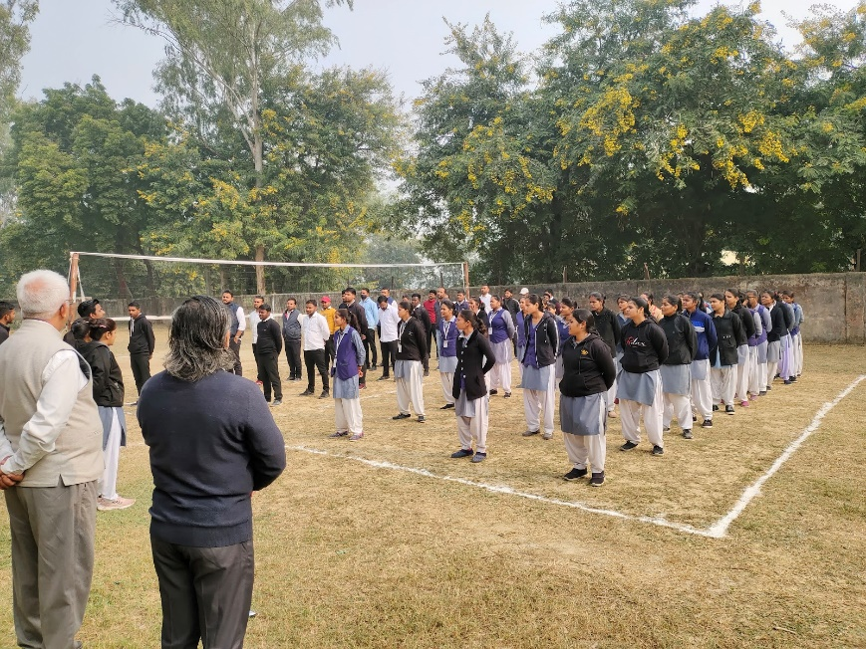
“We have no powers as such, we can only give them suggestions to improve both to the teacher and BSA in-charge. The chain of communication between us and SCERT needs to be improved.”
- DIET Lecturer
Institutional Identity and Focus
Morning assembly observed in one of the DIETs
Majority of activities in DIETs involved the implementation of SCERT-centrally defined programmes
The three main activities
  Pre-service Education
  In-service education
  School support for primary and upper primary classes

Slide 14
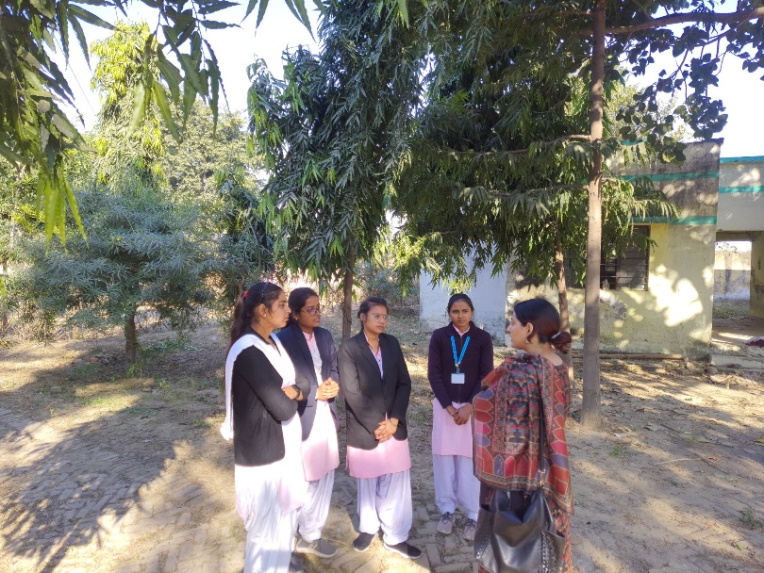
High enrolment, most DIETs have up to 200 students enrolling
Aim is to be employed by the government, but recruitment has been low
Student-teachers use guide-books despite having modules prepared by SCERT
Traditional lecture-based pedagogy, low usage of TLMs and mostly in-active science and math labs
Lecturers feel the curriculum is outdated
Internship was very routine and mechanical
NGO HUMANA active in the pre-service space in a few DIETs
Student-teachers in one of the DIETs
Pre-Service Teacher Education
The course is not challenging at all, the content portion is very outdated. We are sometimes done with the syllabus within just two months, this thereby impacts on the interest and motivation level of the students to pursue it in the long-term. The need for a teacher is not completely full-filled and also the pedagogy part in this course is missing. Here education is present as a subject, but there is no pedagogy of science or nature of science
- DIET Science Lecturer

Slide 15
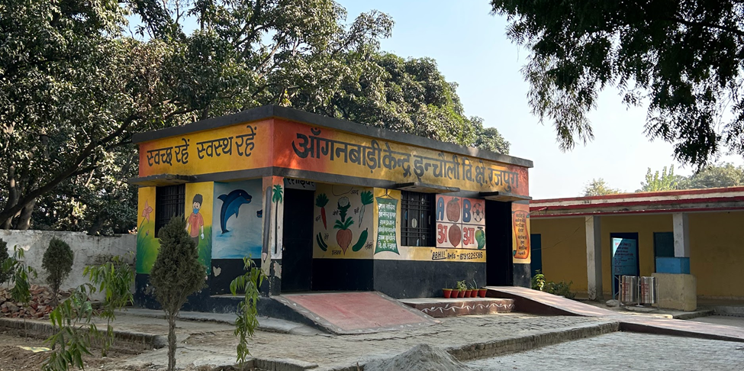
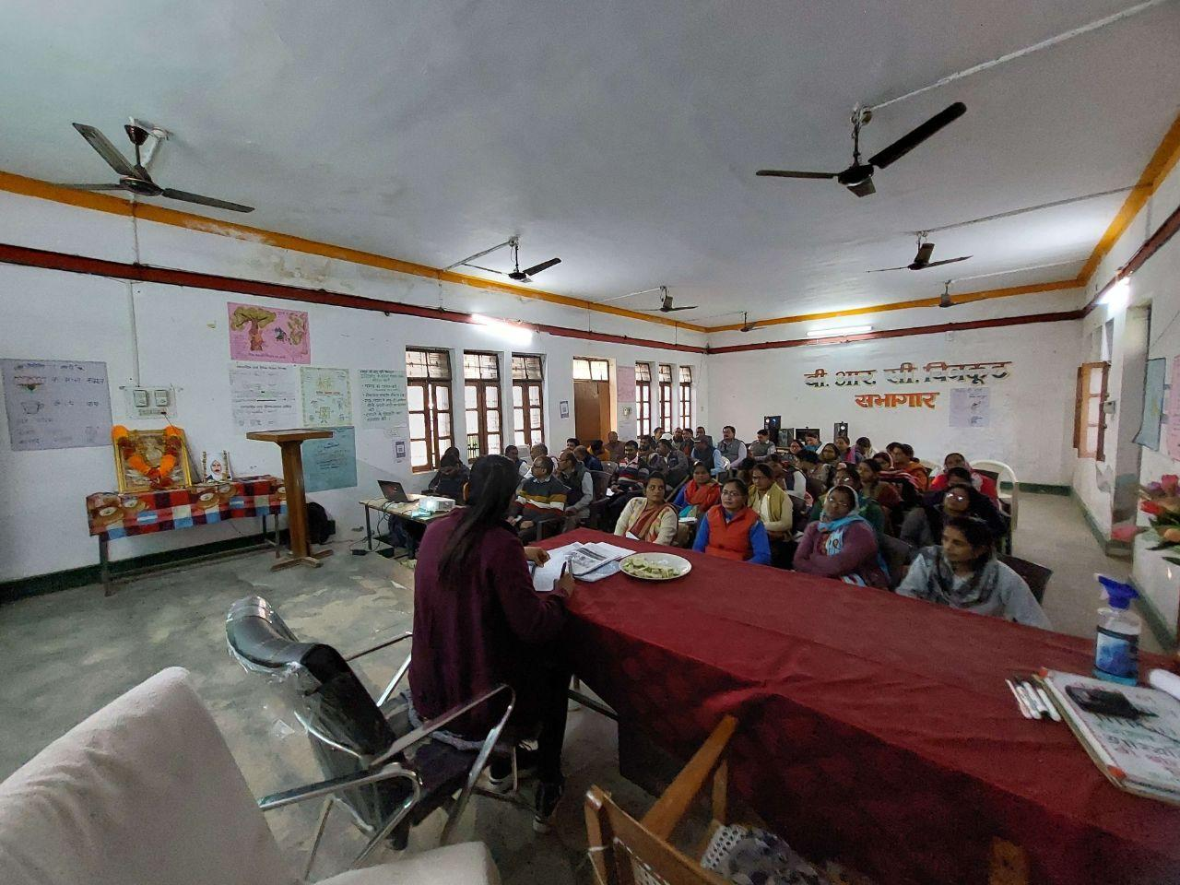
DIETs directly offer continuous professional development programmes to ARPs and SRGs
ARPs and SRGs train teachers in the BRCs
Storytelling competition for teachers active in many DIETs
NIPUN BHARAT programme implementation was visible in all the DIETs, BRCs, and schools.
NGOs Room to Read, Pratham, Sampark Foundation active in in-service space
Professional development is not need-based
Anganwadi workers were given 5 training days each year at the DIET. The state is trying to merge Anganwadis with primary schools
Anganwadi kendra at one of the schools of Meerut
In-Service Teacher Education
In-service training session on English at BRC Karvi, Chitrakoot

Slide 16
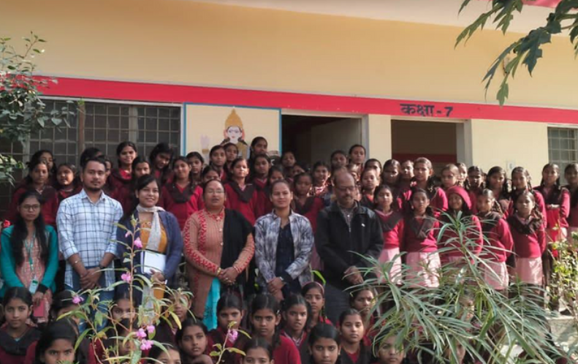
SRGs, ARPs and DIET Lecturers take up school supervision and mentoring
Prerana App created by Samaghra Shiksha is used to record school visits
School visits and records of visits are regular
Monthly meetings take place in DIETs & More frequent meetings take place in BRCs
Some DIETs (Bareilly, Jhansi) also supported KGBV schools
A strong DIET - BRC relationship was not visible
School visits showed pedagogical reforms in language & literacy, but numeracy and EVS/Science were not visible
An attempt to integrate Anganwadi education in Primary schools was seen in Lucknow district schools
Supportive Supervision and Mentoring
“We check on 19 parameters when we go to these schools firstly the presence of teachers we check in the register, enrolment of these students, how many of them are present and whether they are improving at the same level. Besides this, we look into the Mid Day Meal, washrooms, posters on different policies, sports facilities, TLM’s, Math and Science Kits, morning assemblies, cleanliness, discuss their issues”
- DIET Lecturer

Slide 17
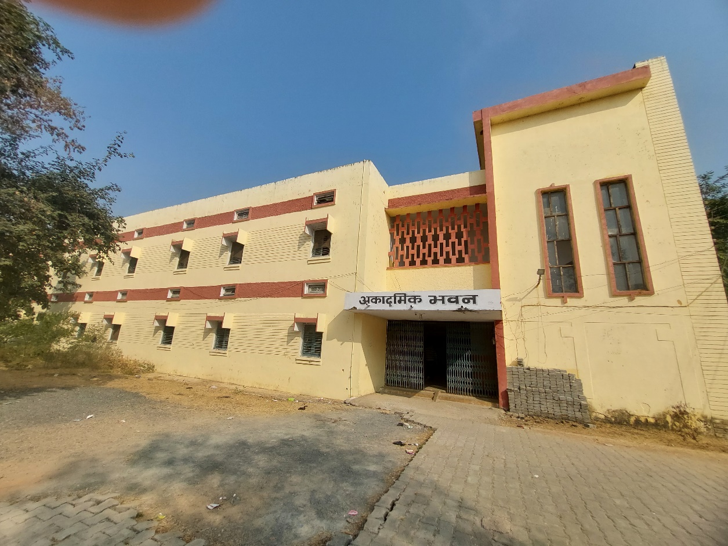
Financial matters in DIETs are arrived at centrally with directives from the SCERT
Two types of budget – General and Specific
Delayed fund disbursement to DIETs was reported as a challenge
Non-sufficient fiscal allocation to infrastructure mobility has emerged as a roadblock for some of the planned activities
FINANCIAL ASPECTS
“When the Mission Prena began, we ARP’s were promised for laptops and tablets but, this has still not been fulfilled. The communication on latest policies to be updated will be much easier when transacted through a tablet.”
- ARP

Slide 18
Table 4.3: Sanctioned Positions in DIETs
Total # of districts: 75 |  |  | Total # of DIETs: 70
Position | Number Sanctioned per DIET (Total for 70 DIETs) | Number of positions filled across 70 DIETs (2013)* | Number of positions filled across 70 DIETs (2022) | % of Positions filled across DIETs (2022)
Academic Posts
Principal | 1 (70) | 23 | 24 | 34%
Vice Principal | 1 (70) | 16 | 30 | 43%
Senior Lecturer | Upto 6 (420) | 79 | 85 | 20%
Lecturers | Upto 17(1190) | 417 | 955 | 80%
Para Academic Posts
Work Education Teacher | 1 (70) | 47 | 18 | 26%
Librarian | 1 (70) |  | 9 | 13%
Laboratory Assistant | 1 (70) |  | 18 | 26%
Technical Assistant | 1 (70) | 36 |  | N/A
Statistician/ Accountant | `1 (70) | 34 | 12 | 17%
Support Staff
Support Staff | 1386 | 848 | No Data Available | N/A
*Data Source : Joint Review Mission on Teacher education of states, Uttar Pradesh GoI(2013)
Limited opportunities for professional development and do not match the lecturer’s needs
Majority of the lectures have a B.Ed degree (trained to be high school teachers)
Junior lecturers are the only members whose duties are academic and were very demotivated about their career prospects
DEVELOPMENT OF FACULTY & STAFF

Slide 19
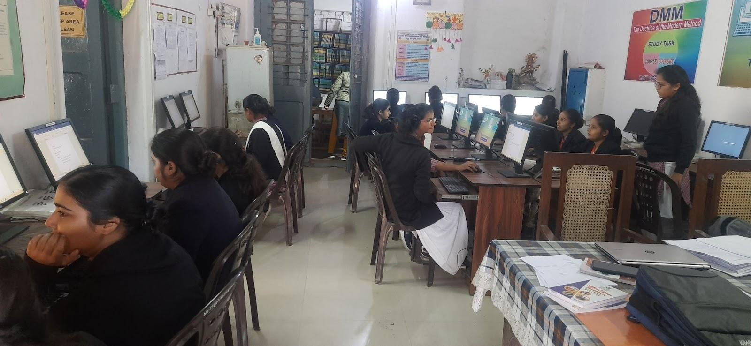
Limited to official periodic meetings at various levels - State, District, Block and Cluster.
No active professional fora or Community of Practice were observed
NGO collaborations for pre & in-service
Collaborations & Partnerships
Computer Lab set up by NGO in DIET Gorakhpur

Slide 20
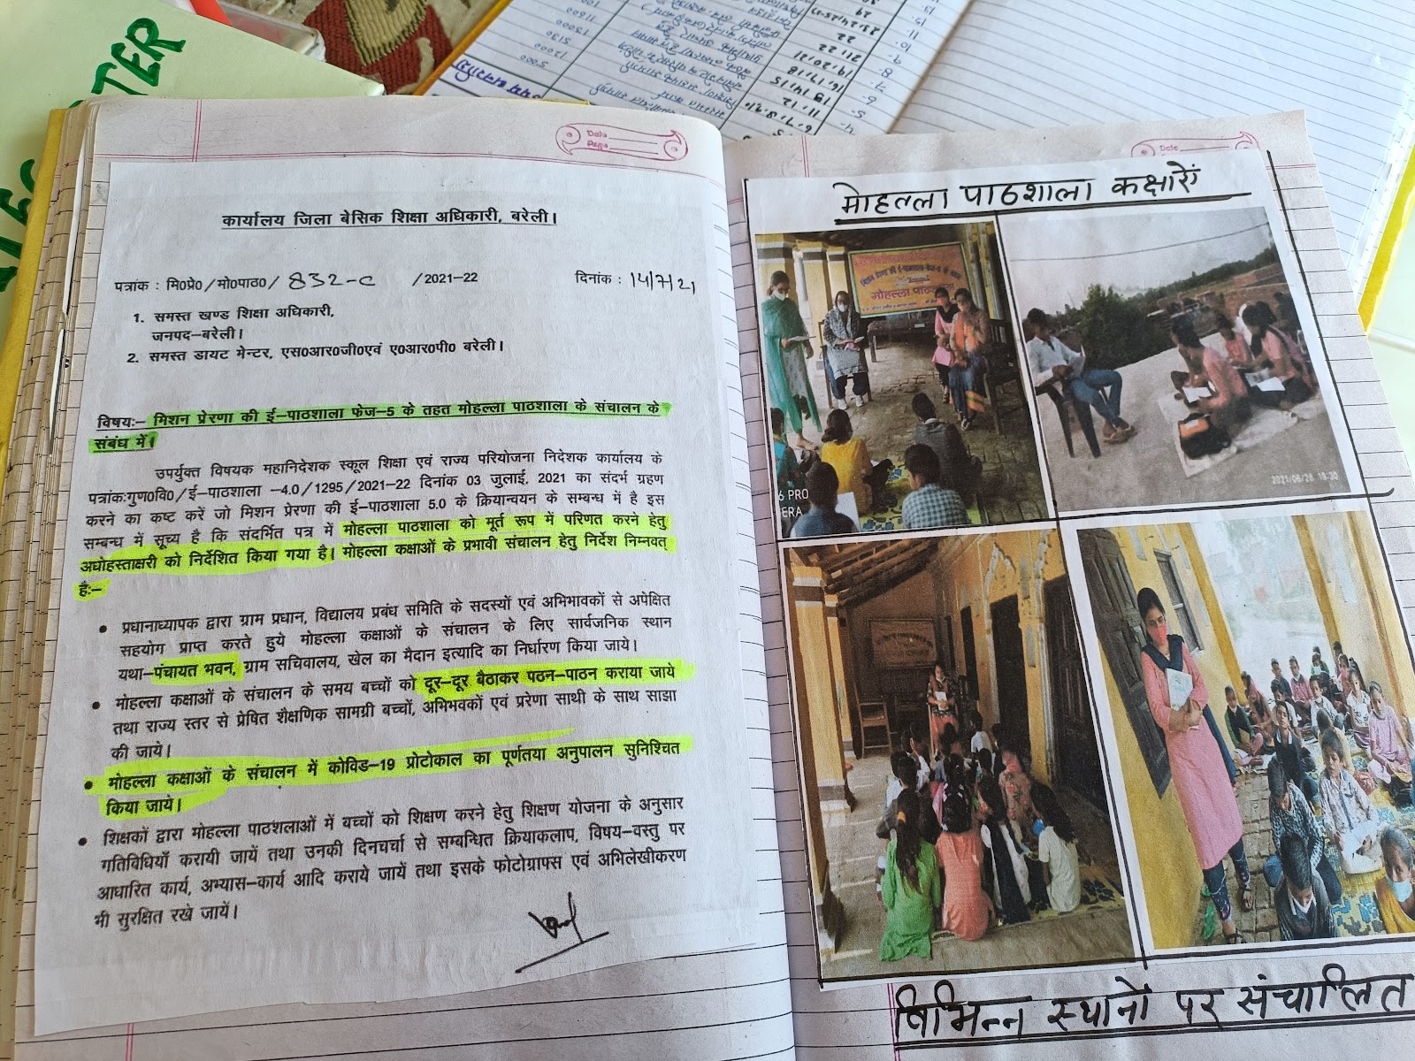
Academic year 2020-2021 no new D.El.Ed admissions
Pratham NGO supported student-teacher’s internship (online)
Facebook groups, You Tube, DIKSHA , Google Meet and Zoom were used
WhatsApp was most popular
Mohalla Schools initiated by a school principal was effective
IMPACT OF COVID-19
A letter regarding Mohalla classes - at an Upper Primary School in Bareilly

Slide 21
  An outdated D.El.Ed curriculum that needs to be updated to reflect the most recent policy and research
  Lack of leadership development programmes to enable DIETs to function as autonomous institutions at the district level
  The absence of a systemic in-service teacher training approach and poor linkages between pre-service, in-service, and school support activities
  DIETs work in isolation and do not leverage collaborations and partnerships
GAPS
AND
SHORTCOMINGS
  A lack of professional development opportunities for DIET faculty and district and block level officers to build academic and research rigour at the district level
  Insufficient linkages between pre, primary, primary, upper primary, and secondary schools
  Weak mathematics and science teaching and learning
  Inadequate basic & digital infrastructure, support for its maintenance, & staffing the DIETs & filling up the vacant posts

Slide 22
  Curriculum requires renewal and modern 21st-century pedagogies required for D.El.Ed
  Efficient but not effective in-service and school support/mentoring
  Poor infrastructure, resources
  Inadequate filling of faculty and staff positions
  DIETs largely working in isolation and implementers of state-centralised plans
SUMMARY OF FINDINGS

Slide 23

RECOMMENDATIONS
BASIC INFRASTRUCTURE
SHORT TERM
Invest in the DIETs selected as CoEs
01
MEDIUM TERM
Expand to other DIETs in a phased manner based on learnings from the operations of CoE DIETs
LONG TERM
All DIETs are equipped with basic infrastructure and adequate human resources

Slide 24
RECOMMENDATIONS
TEACHING & LEARNING RESOURCES
SHORT TERM
1. Creating a database of available resources and plans for maintenance and usage
2. Budgeting and procuring new resources, books & TLMs
02
MEDIUM TERM
1. Creating TLMs using local resources & expertise
2. Developing/curating OERs and digital resources & tools
LONG TERM
Managing repository of resources across DIETs through a portal

Slide 25
RECOMMENDATIONS
DIGITAL TECHNOLOGY
SHORT TERM
1. Computer labs in all DIETs with at least 50 computers with Internet access
2. Plan maintenance for the available & new digital infrastructure
03
MEDIUM TERM
1. Laptops for all DIET faculty and leaders
2. Smart boards in DIET classrooms
LONG TERM
Create an ecosystem for the maintenance and use of digital technologies in DIETs for academic and administrative work

Slide 26
RECOMMENDATIONS
PRE-SERVICE EDUCATION
SHORT TERM
1. Renewal of the D.El.Ed curriculum to reflect the latest research & policy trends in teacher education.
2. Build the capacity of DIET faculty as teacher educators
04
MEDIUM TERM
1. Develop DIETs as research hubs for teacher education & school improvement
2. Build DIET faculty research competencies
LONG TERM
1. Make all DIET faculty and leadership roles academic and provide academic career pathways
2. Align faculty roles with nomenclatures used in other academic spaces and universities as per UGC norms.

Slide 27
RECOMMENDATIONS
IN-SERVICE EDUCATION
SHORT TERM
1. Create a professional development plan (PDP) for the academic year
2. Initiate Collaboration with Universities and NGOs for fulfilling the PDP
3. Capacity building of DTO, BEOs and BSA
05

Slide 28
RECOMMENDATIONS
IN-SERVICE EDUCATION
MEDIUM TERM
1. Training Management System (TMS) and active database of teachers, training needs and activities
2. Development of blended and online courses for teacher’s continuous professional development
3. Develop and manage subject-based teachers’ communities of practice, both online and physical
05

Slide 29
RECOMMENDATIONS
IN-SERVICE EDUCATION
LONG TERM
1. Develop professional teacher standards for self-assessment monitoring and tracking teacher’s professional activities
2. Manage the TMS to facilitate professional development, supervision and career movement of teachers
05

Slide 30
RECOMMENDATIONS
SUPPORTIVE SUPERVISION AND MENTORING
SHORT TERM
1. Capacity building of ARPs & SRGs on mentoring & pedagogy
2. Inclusion of preschool support
06
MEDIUM TERM
1. Develop a holistic plan for school improvement and alignment of all education stakeholders and build structural linkages between DIETs, BRCs/CRCs and schools’ communities of practice, both online and physical
2. Integration of pre- and primary schools Inclusion of secondary school support

Slide 31
RECOMMENDATIONS
SUPPORTIVE SUPERVISION AND MENTORING
LONG TERM
1. Develop career pathways for teachers, both vertical & horizontal (cyclical)
2. Integration of school support from preschool to secondary schools
06

Slide 32
REFERENCES
Akai, H., & Sarangapani, P. M. (2017). Preparing to teach: Elementary teacher education at a
district institute. Economic and Political Weekly, 52(34), 47-55.
Bascia, N and Hargreaves, A. 2000. The Sharp Edge of Educational Change: Teaching, Leading
and the Realities of Reform. Routledge, London.
Darling-Hammond, L. (2006). Constructing 21st-Century Teacher Education. Journal of Teacher
Education, 57(3), 300–314.
Dyer, C., Choksi, A., Awasty, V., Iyer, U., Moyade, R., Nigam, N., ... & Sheth, S. (2004). District
Institutes of Education and Training: A comparative study in three Indian states (No.
666-2016-45480).
Government of India [GoI] (2007). DIETs: Potential and Possibilities. New Delhi. MHRD.
GoI (2011). Approaches to School Support and Improvement. New Delhi. MHRD.
GoI(2013). Joint Review Mission on Teacher education of states, Uttar Pradesh .New Delhi.
MHRD.
GoI(2015). Joint Review Mission on Teacher education of states. New Delhi. MHRD.
GoI (2020). National Education Policy 2020. New Delhi. MHRD.
Lemke & Sabelli (2008). Complex System and Educational Cahnge: Towards a new research
agenda in Mason,M. (Ed.) Complexity theory and the philosophy of education. Wiley-Blackwell, UK.
Mason, M. (Ed.) 2008. Complexity theory and the philosophy of education. WileyBlackwell, UK.
Maurya, N. K., Singh, S., & Khare, S. (2016). Human development in Uttar Pradesh: A district level
analysis. Social Science Spectrum, 1(4), 262-278.
National Council of Educational Research and Training [NCERT] (2005). National Curriculum Framework 2005.
New Delhi: NCERT.
NCERT (2013). Performance Indicators (PINDICS) for Elementary School Teachers. Department of Teacher Education. New Delhi.
National Council for Teacher Education [NCTE] (2009). National Curriculum Framework for Teacher Education: Towards preparing Professional and Humane Teacher.
New Delhi: National Council for Teacher Education.
Ramchand, M. (2020). Learning to Teach: Initial Teacher Education in South Asia. Handbook of Education Systems
in South Asia, 1-36.
Shulman, L. S. (1986). Those who understand: Knowledge growth in teaching. Educational Researcher, 15(2), 4–14.
State Planning Institute Planning Department [SPIPD] (2019). District Wise Development Indicators Uttar Pradesh 2019. Economics and Statistics Division, Uttar Pradesh, India.
Tata Institute of Social Sciences[TISS] (2017). Evaluation of Centrally Sponsored Scheme of Teacher Education in States/UTs. Report submitted to the Ministry of Human Resources Development. Government of India.
https://tiss.edu/uploads/files/CSSTE_Report_Web_22.2.18.pdf .
UNESCO (2021). No Teacher, No Class. State of the Education Report for India 2021. UNESCO, New Delhi, India.
Wilson, E. 2013. Building social capital in teacher education in Evan, M. Teacher Education and Pedagogy. Theory, Policy and Practice. Cambridge University Press, UK.

Slide 33
Thank You

Slide 34
BEST PRACTICES
1
RENEWAL OF THE D.EL.ED CURRICULUM
The Karnataka government renewed its D.El.Ed programme in 2016 through a consultative process including many stakeholders and experts, to build a state-level curriculum framework for elementary teacher education. UP could adopt a similar process.
The BElEd programme of the University of Delhi is a four-year integrated and innovative teacher education programme that includes extensive internship and several courses in theatre, art and self-development. The design of this programme may be adapted to develop a two-year B.El.Ed programme in UP.

Slide 35
BEST PRACTICES
2
CAPACITY BUILDING OF TEACHER EDUCATORS
Several universities offer MA Education programmes. One such programme for elementary school teacher educators is offered in the blended mode. IGNOU also offers MA Education programme in the distance mode. Teacher educators may earn a Master's degree in elementary education while continuing work. Opportunities for DIET faculty can be provided to apply.
Many platforms such as SWAYAM, TISSx, Coursera, and Edx offer short-term courses of varying durations online. CETE, TISS offers contextual short-term modular courses for teacher educators through its Contemporary Perspectives in Education and Research programme in blended and online modes for DIET faculty to update their knowledge and skills.
The School Education Department, Govt of Maharashtra, has partnered with UNICEF to launch & implement the Kendra Pramukh Academic Leadership Programme (KPALP) to enhance teaching skills and improve student learning outcomes. Such a programme could be adopted to develop the capacity of ARPs and SRGs.

Slide 36
BEST PRACTICES
3
DEVELOPING DIETs AS ACTIVE RESOURCE CENTRES
The District Education Resource Centre at DIET Chamrajanagar, Karnataka, was established in 2007 through the active collaboration of DIET and the National Institute of Advanced Studies, Bangalore. Learnings from this resource centre are available as a report.
A compendium of teacher education centres and their function is available as a reference to understanding the different types and contexts of teacher resource centres in India.
The NGO Eklavya has worked with states on science, social science education and primary education in the in-service space & has developed several high-quality resources & books in Hindi.

Slide 37
BEST PRACTICES
4
DEVELOP DATABASES, REPOSITORIES AND PORTALS
The NISHTHA Portal for teacher professional development is an authentic repository of teacher professional development courses developed by NCERT.
TMSs: DIET Serchhip in Mizoram maintains a functional TMS. A lecturer in DIET maintains this facility, which helps map profiles of the entire teacher cadre in the district, the professional development training they have received and the need for future professional development. Mapping is also done by school and subject (TISS,2017). Many more best practices listed in the document could be referenced.

Slide 38
BEST PRACTICES
5
INSTITUTIONAL LINKAGES, COLLABORATIONS & PARTNERSHIPS
University School Resource Network (USRN) project of the Regional Resource Centre for Elementary Education (RRCE), Central Institute of Education, University of Delhi pioneered a new teacher professional development model by building networks of teachers, educators and other education sector persons.
A report on its impact is available for review.
A report commissioned by MHRD (GoI, 2011), Approaches to School Support and Improvement, provides practical guidelines to conceptualize school support and supervision.

Slide 39
BEST PRACTICES
6
DEVELOPING DECENTRALIZED AUTONOMOUS INSTITUTIONS
In the document DIETs Potential and Possibilities, there are several best practices listed.
Particularly Box 2.2 on Page 6, Box 3.1 on Page 10 and Box 6.5 on Page 21 are worth noting.
The Kerala state DIETs are one of the most active functioning DIETs in the country. A visit to Kerala to understand the state's DIET model would be helpful.

