Slide 1
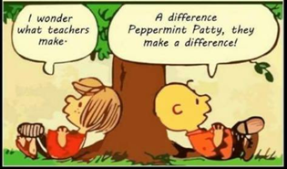
UNESCO-SoER India
Teachers and Teaching
3rd meeting of the Editorial Board
28 July 2021

Slide 2
Feedback from the Editorial Board
As you read the draft and based on your own knowledge of the field, as you listen:
what stories did you find in what we have done?
What stories do you think the report should tell?
What is known but is still worth repeating?
What is new?
What needs to be known but we don’t have research/data?
How do we present this vast landscape? I.e. Organisation of the report and its tables
What needs improvement and sharpening?
What can be dropped?
What needs to be added?

Slide 3
Acknowledge the dedication and work of the team in very adverse conditions:
mental stress and health, excessive workload and digital fatigue, inability to meet and interact, ‘slowing down’ responsiveness.
desire to be ambitious and comprehensive, and make an original and significant contribution through this report.

Slide 4
Chapter 1: context and framework
The teaching workforce (employed currently) in India is about 9.4 million teachers employed in schools in india of which 50% are in the government sector, 35% are in the private sector and 9% are in the aided sector.
(UDISE 2018-19).
2.25% of labour force ‘teachers’ of which
81.29% are ‘school teachers’ (39% primary and 42% secondary),
18% ECCE, 0.22% special education and 0.48% vocational education. (PLFS 2018-19)

Slide 5
Context 1: Pandemic
Transitioning to online and non conventional modes of teaching ‘outside’ school
Job loss and salary cuts.
Important of teachers and schools.
Particularly for ‘foundational’ period.
Digital divide

Slide 6
Context 2: NEP 2020
(1) Replacing the 2-year Bed as the dominant mode with a 4-year BA-Bed/BSc-Bed programme with pathways to ECCE, primary, subject areas.. (2) Improving working conditions of teachers and involving them in school governance, and recognising their autonomy (3) Creating a needs and interest based system of continuous professional development (4) Creating and instituting professional standards which will govern the profession (5) Improving teachers management, with greater recruitment at school complex level, teacher resource optimisation at school complex level, transfer policy, filling vacancies, ensuring availability of subject teachers. (6) Strengthening quality by improving the teacher eligibility test, which will be required even for private school employment, attracting more rural students with knowledge of local languages into the system with more scholarships for students. (7) Strengthening regulation and oversight of teacher education colleges so that substandard programmes are eliminated and all teacher education begins to take place in multidisciplinary environments and composite institutions. Placing Teacher Education within Higher Education, and integrating Teacher Education regulation into Higher Education regulation. (8) Raise status of the profession, to attract talent and cultivate excellence.
And in general it notes the need for:
(9) Extensive use of technology to improve teaching learning and educational planning and management, (10) A light but tight regulatory framework to ensure integrity, transparency and resource efficiently, (11) Outstanding research for the sector (12) Continuous review of progress based on sustained research and assessment

Slide 7
Context 3: SDGs
SDG 4: Ensure inclusive and equitable quality education and promote life-long learning opportunities for all
4.c By 2030, substantially increase the supply of qualified teachers
Operationalised through the UNESCO Teacher Policy Guidelines
Recruitment and retention
Teacher education (initial and CPD)
Deployment
Career structure and paths
Employment and working conditions
Reward and renumeration
Standards
Governance
Accountability

Slide 8
Context 4: The Indian education system
Political and administrative structures of the Education systems is based on principles of federalism and decentralisation.
Regional differences, and rural urban differences exist wrt development
Schooling sector includes large private/non state segment
Indian society is stratified on lines of caste, gender, class.
2009: RtE
Since 1980s several central mission directed at increasing supply of teachers/qualified teachers, stabilising PTR, setting norms, increasing teaching quality)
Centrally Sponsored Scheme for Teacher Education (CSSTE) DPEP, Sarva Siksha Abhiyan, Rashtriya Madhyamik Shiksha Abhiyan, Samagra Siksha

Slide 9
Chapter 2: profiling teachers
A total of 9,430,839 teachers are employed in the 1,551,000 schools across India.
52% of all teachers work in elementary schools, 24% in composite schools and 24% in middle to senior secondary schools. 72% of all teachers work in schools located in rural areas (of these 60% are in government schools and 26% in private unaided schools).
28% teachers work in urban areas. 50% are employed in government schools and about 35% in the private unaided sector (the comparable share of schools is 67% govt and 21% private unaided, table 2.1).
A large proportion of private school teachers (45% of teachers employed in private unaided schools) are employed in composite schools (23% of all private unaided schools) and 56% of these are in urban areas.

Slide 10
Teacher availability
The overall PTR for all schools is 26:1, with 23:1 for elementary schools, 28:1 in composite schools and 31:1 in middle, secondary and senior secondary schools. In general PTRs in secondary schools tend to be higher and between 43:1 and 47:1.
7.15% of all schools are single teacher schools and of these, 89% are in rural areas. State with high percentage of single teacher schools include Andhra Pradesh (14.4%), Arunachal pradesh (18.22%), GA (16.08%), Jharkhand (13.81%), Madhya Pradesh ( 13.08%), Rajasthan (10.08%), Telangana (15.71%) and Uttarakhand (13.64).
19.42% of schools have teacher vacancies. States with a large percentage of schools with vacancies include Bihar (56.03%), Jharkhand (39.98%), Uttarpradesh (32.66%), Delhi (21.94%) and Madhya Pradesh (21.66%).
The total additional teacher requirement (based on this this PTR) is about 1,116,846, with 69% of these teachers required in rural areas. States which have larger proportion of teacher requirement include UP (3.2 lakh) Bihar (2.2 Lakh), followed by Jharkhand, Maharashtra, Karnataka, MP and West Bengal (between .6 and .8 lakh).
80% teachers are graduate, and 84% have professional qualifications (overall); only 77% in private unaided sector are professionally qualified. North East has less than 50% qualified teachers.

Slide 11
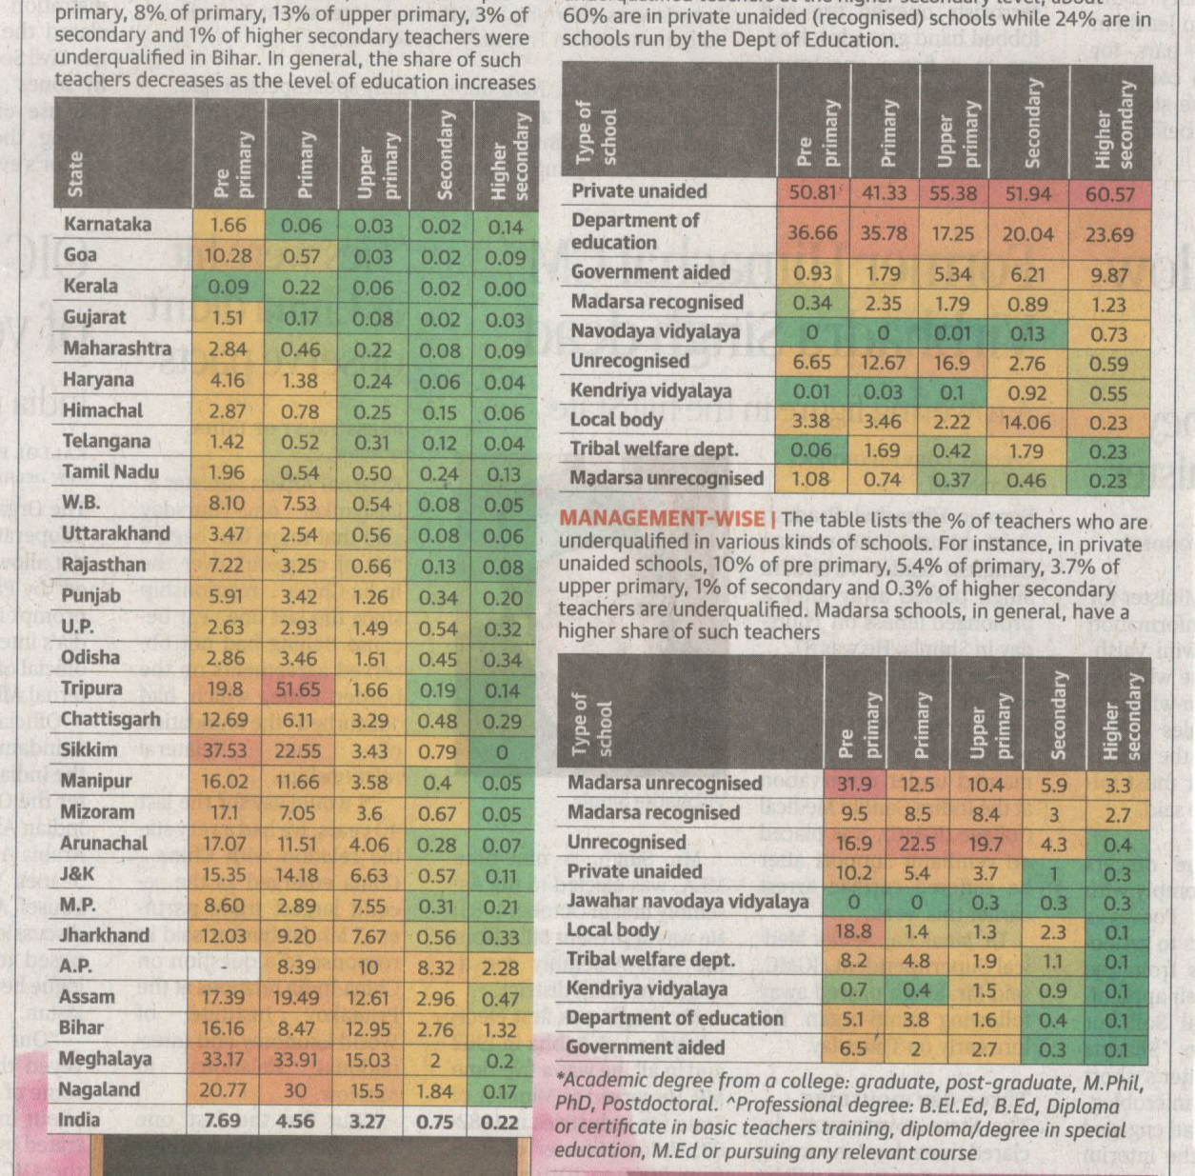
How qualified are teachers in India?
Interstate variation
By level of school
By type of management

Slide 12
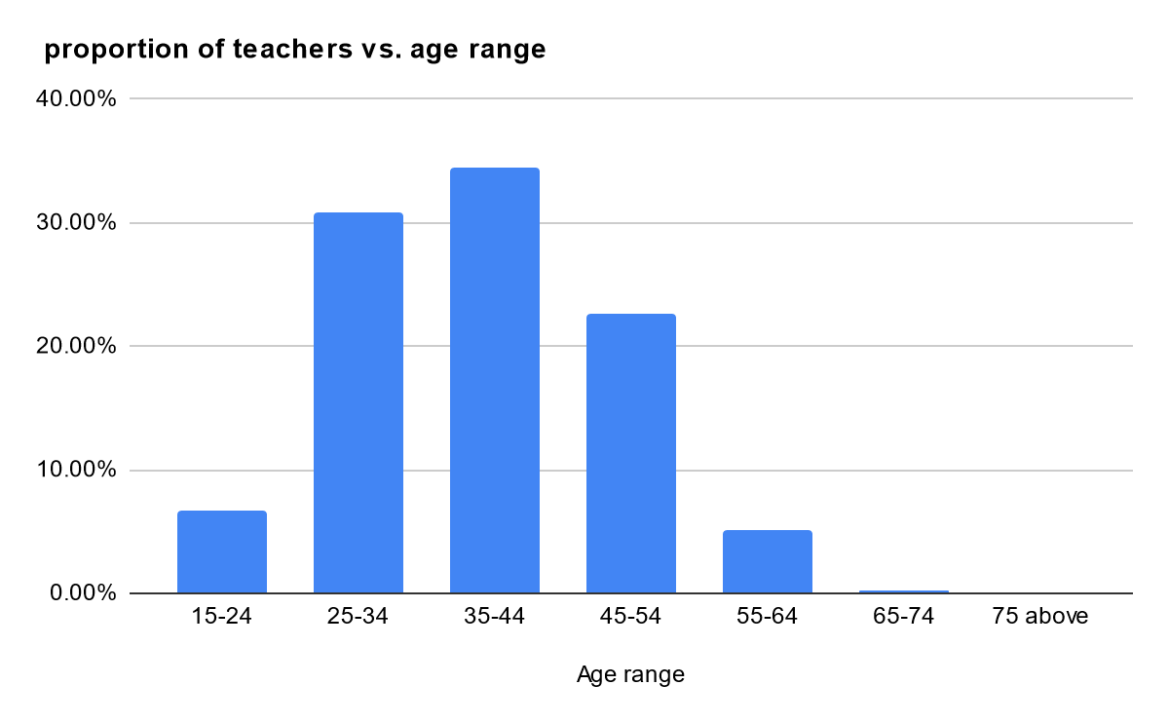
Demographic profile
Women teachers: 50% (totally): in govt 43% and in private unaided 62%. 73% of urban private unaided school teachers are women, 61% of urban government school teachers are women.
States which have been ranked high on PGI also have high proportion of women teachers.
From NSS
48% of teacher labour forceis female as opposed to 24% of total labour force.
Early childhood is most feminised at 84% followed by primary education (43%), secondary (38%) and vocational education (32%)
Early childhood educators (rural and urban) are very likely to be
women (over 80%)
Primary school teachers in urban areas are likely to be
women (63%)
Special educators in rural areas are very likely to be
women (79%)
Demographic profile of ECCE, primary and secondary is
comparable to the national picture.
However, very few special educators are SC/ST
Vocational education: only 6% and 8% respectively.

Slide 13
Type of contract, remuneration and benefits-1
DISE 2018-19: A total of 13% of teachers have contractual appointments: 12% of government school teachers and 16% of teachers in private unaided schools.16 states where 20% or more are on contractual employment include Himachal Pradesh 33%, Chandigarh 21%, Punjab 33%, Delhi 25%, Haryana 25% (DN 43%, DD 24%?, In the eastern region: Jharkhand 41%, Odisha 22%. In the South Lakshadweep 20%, Several North eastern states: Tripura 22%, Sikkim 36%, Manipur 35%, Arunachal Pradesh 58%, Mizoram 58% Meghalaya 52%. 74% of all teachers on contract are in rural areas. In the states of Odisha, West Bengal,Jharkhand, Assam and Meghalaya over 90% of all contractual teachers are in rural areas.
PLFS: Most non Government/Privately employed teachers report not have any job contract--70% of school teachers. 58% of early childhood teachers also report not have any job contract. Only 17% of school teachers report having contracts for more than 3 years; 29% of ECE teachers also have contracts for more than three years. As can be expected, there is significant difference in the salaries of teachers in the two groups. An ECE teachers with no contract receives 48% of the salary of a teacher with a 3 year contract (Rs 6757 vs Rs 13931). A school teacher with no contract receives only 44% of the salary of a teacher with a 3 year contract (Rs 11096 vs Rs 24714).
In the government employment sector, while overall the number of school teachers with contracts of more than 3 year is high, at 67%, there are as many as 28% of school teachers working with no contracts. In the early childhood education sector, only 49% teachers report having contracts more than 3 years, while 35% report have no contracts. In the special education sector, only 13% report have contracts more than 3 years and 80% have no contracts! However, unlike the private employment sector, the salary differentials between the two groups are not very significant (Rs 29986 vs Rs 33099 for government school teachers)

Slide 14
Type of contract, remuneration and benefits-2
Not eligible for any benefits: 59% of those employed in private sector and 19% of all those employed in the government sector.
Maximum benefits (P/F-pension gratuity, healthcare adn maternity leave): 41% of all government teachers, and 49% of all 11% of those employed in the non-government/private sector.
Within government employment, 49% of early childhood education teachers are not eligible for any benefits, only 15% receive maximum benefits and 9% receive only health care and maternity benefits.
11% of those employed in private sector and 22% employed in government sector receive PF/pension, and no other benefits. This suggests a high level of vulnerability among teachers employed in the private sector as well as teachers of early childhood education, whether employed by government or private sector.
Within government we find 11% school teachers (primary and secondary) with none or very limited benefits receiving salaries much less than others with benefits: not eligible for any benefits (10%) at Rs 12,313.00 and those receiving only gratuity (1%) at 17,531.00. The salary of those with all benefits is about three times that of those with no benefits (Rs 35,492.00 vs Rs 12,313) In the non-government/private employment sector, those receiving all benefits receive about three times the salary of those who are not eligible for benefits (Rs 28,021 vs Rs 9,115).
61% of primary school teachers and 57% of early childhood education teachers employed in the private sector are amongst the most vulnerable, drawing very low salaries of Rs 7,286.00 and Rs 6,546.00 and not eligible for any benefits.

Slide 15
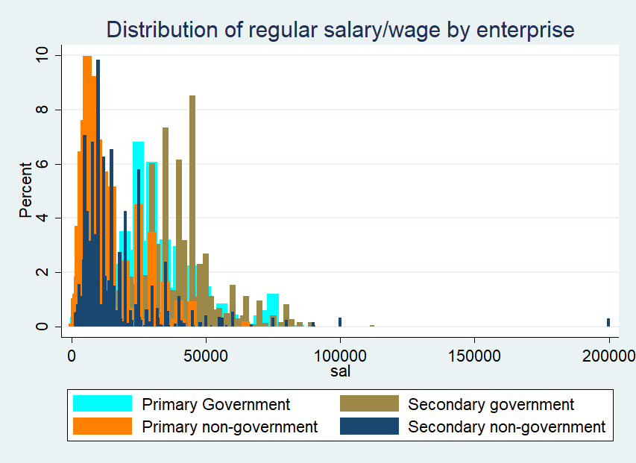
Type of contract, remuneration and benefits-3
The wide variation within government teachers is largely accounted for in terms of years of service.
Age range | Primary school teacher | Secondary school teacher
15-24 | 11,508.08 | 15,579.10
25-34 | 21,822.36 | 24,867.87
35-44 | 26,033.73 | 33,504.50
45-54 | 35,289.96 | 40,867.03
55-64 | 39,797.74 | 47,405.61

Slide 16
95% of all teachers are regular salary wage earners. The overall average monthly salary for all teachers is Rs. 21,671.00 and for School teachers (primary and secondary): Rs 24,519.00, however, there is considerable variation within the profession. The average salaries of primary, secondary and vocational education teachers is much higher at at Rs 22,154.00, Rs 26,794.00 and Rs. 23,510.00 while early childhood education teachers earn and average salary of Rs 9,352.00 and Rs 14,863.00 for special education teachers.
Across all groups, except vocational education, women earn about 60% of what men earn ( Average of Rs 16,435.00 vs Rs 26, 594.00). Rural women earn 55% of what rural men earn ( Rs 13220 vs Rs 24,056). The average salary of women early childhood education teachers in rural areas is the least at Rs 6,924.00.

Slide 17
Working conditions
North Eastern States and rural schools have considerably poorer basic amenities:
Access by roads: States with only 59% to 68% schools with road access are mostly in the North Eastern Regions (Arunachal Pradesh, Assam, Manipur, Meghalaya, Tripura and Sikkim) and the states of Jammu Kashmir and Himachal Pradesh--all in the mountainous regions of the country.
Drinking water and toilets: 4 North eastern states however have much lower provisioning: Arunachal Pradesh 52%, Meghalaya 34% Nagaland 59% and Tripura 73%. The North Eastern states have much lower levels of provisioning--Arunachal Pradesh 64% boys and 65% girls, Assam 66% boys and 70% girls, Meghalaya 63 % boys and 59% girls, Manipur 67% boys and 66% girls, Tripura 74% boys and 76% girls. Chhattisgarh 73% boys, Rajasthan 78% boys and Andhra pradesh 60% boys, 68% girls are among other states with relatively lower levels of provisioning of basic amenities. Meghalaya rural schools with only 58% toilets for girls has very low provisioning.
Electricity: Very low level of electrification are reported from schools in the North Eastern states of Arunachal Pradesh (40%), Assam (30%--27% rural and 80% urban), Meghalaya (19%, 16% rural and 59% urban), and Tripura (34%) and Odisha (3 8%). A much smaller proportion of rural schools in these states have functional electricity.
Conditions of classrooms: Overall only 65% schools have all classrooms in good condition, 62% of rural schools and 83% of urban schools. States with 60% or less schools with all classrooms in good condition include Andaman (57%), Arunachal Pradesh (37%), Assam (28%--27% rural and 43% Urban), Himachal Pradesh (58%), Jammu Kashmir (54%), Meghalaya (42%, 40% rural, 64% urban), Manipur (40%), Mizoram (42%), Sikkim (50%), Tripura (37%), Uttarakhand (54%), West Bengal (41%).

Slide 18
Professional conditions
Free textbooks: Overall 78% of schools received free textbooks. States with low levels of coverage include states from the North East including Meghalaya (63%), Mizoram (59%).
Libraries: 64% in rural areas as compared with 73% urban schools. States with very low levels school libraries include the North Eastern states of Arunachal Pradesh (13%), Meghalaya (4%), Manipur (17%), mizoram (10%), Nagaland (27%) and Tripura (15%)--where availability of books in tribal languages is likely to be a concern. Bihar (32%), Jammu Kashmir (36%) and Uttar Pradesh (40%, with only 6% rural schools having libraries) also have low to very low levels of provisioning of school libraries. States with impressive achievement in terms of provisioning libraries include the smaller Union Territories of Chandigarh (93%), Delhi (95%), Daman and Diu (97%), Lakshadweep (96%) and in addition Punjab (88%), Jharkhand (89%), Haryana (86%), Karnataka (88%), Kerala (85%), Madhya Pradesh (90%), Pondycherry (88%), and Telangana (88%).
Access to internet and computing devices: The overall availability of computing devices (either desk top or lap top) is 22% for all India, with provisioning in rural areas at 18% being much lower than urban areas at 43%. Access to internet is 19% all India, with only 14% in rural areas as compared to 42% in urban areas.
Academic supervision visits The overall extent of supervision visits by academic supervisors such as Block and Cluster Resource Persons and District Academic Inspectors in schools is reported at 73% overall with 76% in rural areas and 57% in urban areas.

Slide 19
Changes and trends between 2013-14 and 2018-19
 | Change between 2013-14 and 2018-19
PTR (overall) Professionally qualified teachers Graduate teachers Single teacher schools Total schools with PTR>35:1 Schools with functional drinking water availability Schools with functional boys/girls toilets | 31:1 to 26:1 +23% +35% -5% -28% +1% +16% (boys) +14% (girls)

Slide 20
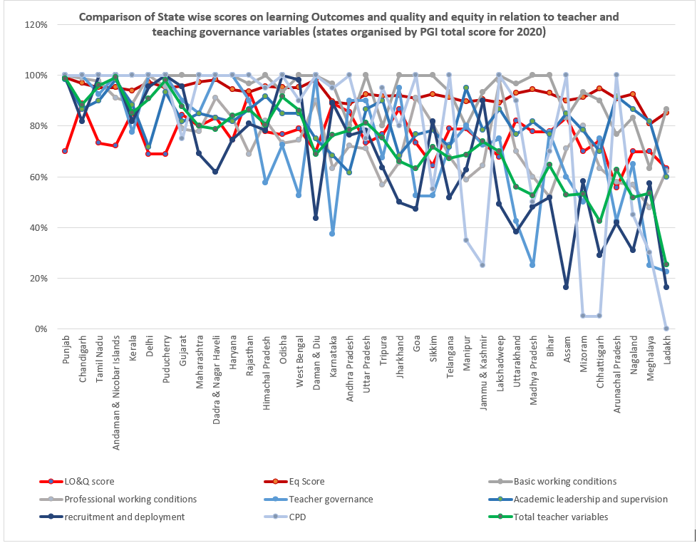
Between states

Slide 21
Aspirational districts
In general all aspirational districts have a higher percentage of rural schools compared to the state and with reference to the national proportion (72%). Aspirational districts with very high proportion of rural schools include Udalgiri (93%), Assam, Gumla (92%), Jharkhand, and Ri Bhoi (96%), Meghalaya.
In all cases the proportion of government schools is more than that of the state. Dantewada with 95% government schools has by far the highest proportion. The proportion of government to private unaided and private aided schools varies widely between these districts.
Most of the aspirational districts have a higher percentage of single teacher schools compared to the state. This is indicative of the challenges that the districts probably face with reference to staffing. This is also seen from relatively higher PTRs seen in almost all of the districts. In almost all cases, there are more schools with vacancies in the Aspirational Districts in comparison to the state as a whole.
The proportion of women teachers in all the aspirational districts is far lower than the state and in comparison with the all India figures of 50%.
Basic amenities: All aspirational districts fare poorly with respect to provisioning of functional boys and girls toilets, Electricity provisioning is also at best at the level of the state (Udalguri at 32%), but is generally below the state level by about 15 to 20% points.
Professional working conditions: no noticeable pattern pertaining to disadvantageous conditions, except wrt devices and internet availability.

Slide 22
Chapter 3
The teaching profession, careers and career governance
Teacher Recruitment and deployment
Career structure/path , Rewards and Recognition
Employment & Working Conditions
Accountability & School Governance

Slide 23
Chapter 3 Key Findings
Direct recruitment is merit-based and depending on academic performance, TET & additional state level tests
  Calculation of vacancies is based on PTR, and subject teacher vacancies are high especially in middle school
  Subjects like Art and Physical Education recruitment is only contract or parttime
  No system in place to calculate teacher demand
  Retention is not a problem in India
Indirect recruitment /Deployment
  Only few states have transparent computer-based systems
  Most states there are mass transfers and political involvement in deployment and transfers
Career structure/path , Rewards and Recognition
  There are no formal career pathways , promotion is based on seniority and not performance ; For contract teachers, getting regularied is considered promotion
  National and state awards for regular teachers, no formal recognition for contract teachers
  Teacher unions have opposed performance based promotions on the grounds that this is likely to be non transparent and also lack objective criteria.
  Most CRCs are men , primary school women teachers don’t take head teacher roles
  Informal horizontal differentiated responsibilities exist

Slide 24
Chapter 3 Key Findings
Employment and working conditions
  Basic amenities and professional amenities are improving
  Corporal Punishment persists and is addressed only from a legal framework ; Teacher’s belief that some CP is necessary for learning is cultural
  Violence in schools is high among students, teacher to student high among socially marginalised and student to teacher is increasing in urban areas.;
  Teacher to student violence leads to poorer math learning outcomes
  Very few studies on school violence
  Flexibility and autonomy (decision making) in work and job security were two main reasons for job satisfaction
Accountability
  Teacher standards, monitoring and evaluation systems are weak or yet to be developed,
  Perception of a lack of accountability among government school teachers
  Absenteeism and teacher absence need to be distinguished ; Teacher’s instruction /classroom time needs to increase and other tasks need to reduce
  When control between management and teachers was less there was more variability in pedagogy among teachers

Slide 25
Chapter 3 Trends
Most states are recruiting contract teachers and regularising after different -periods (3 to 7 years); Contract teachers salary significantly lower than regular teacher
Accountability measures tending to be more disciplinary including rigid monitoring
Some states are attempting to automate the recruitment and deployment process to make it more transparent. Karnataka , Tamil Nadu have been successful
There is significant improvement in the basic and professional amenities for teachers and student
Teacher transfers are politically influenced in majority of the states; Teacher non-educational activities have not reduced on ground despite RtE stipulating reduction.
Student to teacher violence is on the rise in urban areas and needs to be researched more, especially where there is a large difference in socio-economic levels between teacher and student

Slide 26
 | Performance Grading Index. Domain | weight | Overall weightage
1 | Learning Outcomes and Quality | 180 | 18%
2 | Access | 80 | 8%
3 | Infrastructure and Facilities | 150 | 15%
4 | Equity | 230 | 23%
5 | Governance Processes Indicators pertaining to teachers/head teaches and wholeschool governance: % of teachers whose unique ID is seed in any electronic data base of the state government/UT administration; % of average daily attendance of teachers recorded in an electronic attendance system; % of schools at elementary level displaying photo of elementary teachers for govt and aided schools; % of single teacher primary schools; % of primary schools having PTR as per RTE norms; % of primary and upper primary schools meeting headteacher norm as per RtE; % of secondary schools having principals/headmasters in position; % upper primary schools meeting norms of subject-teacher as per RtE; % secondary schools who have teachers for all core subjects; details of visits to elementary schools during the previous academic year; % of teachers evaluated; % of govt. Head teachers who have completed school leadership training during financial year; % of schools that have completed self evaluation and made school improvement plans during the financial year; % of teachers provided with sanctioned number of days of training during the financial year; number of new teachers recruited through a transparent online recruitment system as % of total number of new teachers recruited during the year; number of head teachers recruited through a merit based selection system as a % of total number of head teachers/principals during the year, | 360 250 (ie 70% of governance) | 36% (25% overall pertains to teachers and school leaders)
 | Total | 1000

Slide 27
Chapter 3 Recommendations
Computerised systems and transparent processes for recruitment and deployment with minimum political influence ;
Teacher information systems need to be created to manage careers and develop more transparent processes
Clear policies and processes to regularise contract teachers recruit qualified regular teachers and develop processes to calculate subject specific demands is required. Subjects such as art, physical education need attention.
Development of teacher standards to be used for pre-service and in-service and mechanisms for local teacher support , feedback on self-evaluation and nurturing of teacher communities is essential to develop more democratic and less disciplinary modes of accountability
Pedagogical frameworks for addressing corporal punishment is needed; More research on school-based violence is necessary

Slide 28
Chapter 4: Initial Teacher Education
Providers
Ten-fold increase in the number of private teacher education institutes in the country since 1990s
Total number of teacher education institutes (TEIs) recognised by NCTE as on 2020 is 16754
92% of them are privately run
724 integrated ITE programmes offering B.Sc-B.Ed/B.A-B.Ed recognised by NCTE. Total approved intake is 63,770.
60 institutes across the country currently offer the B.El.Ed programme
Distribution of TEIs across the country uneven: Assam there are 101 TEIs with a total intake of 9840. Maharashtra has 1098 TEIs and an intake of 92855
The Rehabilitation Council of India (RCI) is the statutory body responsible for preparing human resources, including teachers for the education of children with disabilities
Currently 782 institutes approved by the RCI. Includes the nine national institutes focusing on specific types of disabilities
Geographical spread of RCI approved institutes also skewed. UP has the maximum with 158, followed by Maharashtra with 94 institutes and one in Meghalaya
A majority of RCI approved programmes are diploma in special education focussing on a single disability

Slide 29
Initial Teacher Education
Types of programmes & Intake
1.84 million teachers of various types are prepared every year (excluding teacher educators from M.Ed and M.P.Ed programmes)
139419 professionals and personnel registered with RCI. 75% are engaged in special education. Rest are audiologists, speech therapists, hearing aid technicians, rehabilitation psychologists etc.
Currently no selection procedure for entry into teacher education programmes recognised by NCTE. Norm set by NCTE for admission into any programme is 55% marks in the qualifying examination. The NEP 2020 recommends an all India aptitude test to select students for all teacher education programmes.
RCI conducts an all India Online Aptitude Test (AIOAT) annually for admission to various RCI approved Diploma level programs. In 2018, it was held at 98 test centres across the country. For 19706 seats, 32432 appeared for the test. But only half the available seats are filled. Many programmes appear to struggle to attract students. Ex; two-thirds of the available seats for D.Ed in Cerebral Palsy vacant.

Slide 30
Initial Teacher Education
Curriculum
Curriculum of teacher education was not regulated until 2014. While universities design their own curriculum, all NCTE recognised programmes must adhere to the recommendations of NCFTE 2009.
All RCI approved programmes must follow the mandated curriculum.
NEP 2020 recommends a move towards four year integrated teacher education programme across levels
NCTE, in consultation with NCERT, is currently developing the curriculum for the proposed four year dual degree programme. Greater synergy between NCTE and RCI to design the course curriculum for preparing subject teachers to teach children with disabilities is planned

Slide 31
Initial Teacher Education
Recommendations
It is globally recognised that along with a robust disciplinary knowledge, the knowledge base for teaching includes curriculum knowledge, pedagogic knowledge, pedagogic content knowledge and knowledge of assessment.
Teachers’ understanding of the content in the discipline must include tools used to organise, construct and validate the content and students’ conceptions in learning this content..
Teaching is a purposive, moral and ethical activity and hence this knowledge base must include addressing the beliefs, attitudes, skills and competencies of teachers.
Contexts are crucial for teachers. While no single programme can possibly prepare teacher for the diverse contexts of schools that prevail in the country developing adaptive expertise in teachers is essential
Teacher education programmes that support formation of CoPs and practitioner research have the potential to prepare teachers who are autonomous and exercise agency

Slide 32
CTET Paper analysis
Testing of teachers’ knowledge base
The CTET test papers privilege content knowledge rather than professional knowledge associated with and arising out of content knowledge: 50% of questions in paper 1 (for grades 1 to 5) and 61% of paper 2 (grades 6 to 8) on CK
Testing of thinking abilities
Higher proportion of knowledge-level questions (~70%), apply (14% items in paper 1 and 21% items in paper 2), and analysis (14% items in paper 1 and 12% items in paper 2). In paper 1, 10% of the items of the ‘evaluate’ type.
Key recommendation for the design of CTET.
The Test must be aligned to what we currently understand about knowledge base for high quality teaching.
It must include:
more dimensions of teachers’ professional knowledge capabilities
include knowledge and understanding of constitutional values
evaluate the practice of teachers through an assessment of lesson plans of teachers, as well as observation of practice.

Slide 33
Chapter 5
Quality of Teaching
Dominant pedagogic practices
Variation in pedagogic practices
Factors influencing adoption of pedagogic practices
What works and why?

Slide 34
Dominant pedagogic practices
Textbook/Teacher-centric pedagogy
Student-centric pedagogy
Authority of knowledge from textbook/teacher
Transmission based pedagogy
Limited use of TLMs
Textbook based tasks focusing on memorisation
Individual work
Monolingual approaches
Assessment of achievement and remedial instruction
Strict discipline
Repeated practice for remediation
ICT use for transmission
Valuing student expressions and inclusion of local knowledge
Student explore TLMs and express ideas
Inclusion of open ended/ problem solving tasks
Group work
Multilingual and translingual approaches
Assessment for learning
Establishing discipline democratically
Inclusive pedagogic practices
ICT for exploration and knowledge construction

Slide 35
Pedagogical variations
Integration of approaches- ‘Eclectic pedagogy’ instead of clear dichotomies in pedagogic approaches
Variation in pedagogies in relation to subject specific approaches
  Literacy practices indicate monolingual mindset of teachers, lack of resources for teaching in mother tongue but also indicate informal codeswitching between languages for explanations.
  Mathematics teaching have focused on calculation, memorisation of formulas and repeated practice of similar problems. Even after curriculum reform teachers’ rue that extra practice questions are not there.
Discriminatory pedagogies with respect to caste, class, gender may exist irrespective of teacher-centric/student centric pedagogies and depend heavily on teachers’ beliefs
Inclusive pedagogies adopted rely on recitation, recall and copying text in absence of professional inputs for developing adaptive expertise, confused directives, lack of adaptive technologies, low expectations of students’ abilities
Pedagogical variation with respect to public and private school indicated existence of regressive pedagogical regimes in low-income catering private schools as well as progressive pedagogical innovation by individual teachers in government schools
Gaps in understanding of pedagogic approaches for multigrade schools in teacher education and lack of support and infrastructure though government interventions exist

Slide 36
Why dominant pedagogic practices?
Role of teachers’ personal beliefs about learning, pedagogy, nature of discipline, learners’ ability, teachers’ role and their self efficacy- Negative beliefs lead to impediments in learning while positive beliefs support students in boosting learning outcomes - Beliefs influenced by cultural norms and values - Reflection on beliefs and supporting teachers’ agency in pedagogical decisions as crucial
Role of pedagogical content knowledge (PCK) in understanding students’ thinking behind the conceptions and selecting and using resources- Not focused in teacher education and CPD to large extent
Interventions circumventing teachers’ agency are difficult to sustain as superficial changes to pedagogy fail to achieve outcomes
Though the rubrics for evaluation of quality of teaching have evolved and integrated the socio-constructivist perspective for teacher learning and connections between teacher, school and society, there are limited opportunities for teaching observations and feedback from CRC/ BRC/ Principals/ Headmasters- Peer observation and feedback not an institutionalised norm
BRC/CRC mired in data collection, need professional development opportunities for academic and pedagogic leadership as well as use of ICT resources

Slide 37
Ch-5 Recommendations
Lessons learnt from Interventions that have worked to support inclusive and innovative pedagogies
  Scaled packages including curriculum materials, resources and continuous professional development focusing on beliefs, knowledge and pedagogy - may involve blended learning
  Socially responsive/inclusive/ critical pedagogies need continuous professional development- those existing in vivo needs to be recognised, appreciated and disseminated to larger audiences to build inclusive culture
  Contextualised pedagogic practices / PCK-backed pedagogies have worked in quasi-experimental designs but still needs to exhibit scale
  Collaborative and Participatory TPD design with teachers in designer role provide social conditions for teachers to learn from each other and experts
Recent innovations using ICT for TPD need to consider the factors supporting the dominant pedagogies and ways to address them
Need to enhance teachers’ position as agents of social change and reflexive professionals with adequate institutional support
Role played by ‘Voluntary Teachers Forums’ and ‘Communities of Practices’ in supporting and sustaining teachers’ agency and pedagogic change

Slide 38
Chapter 6
Teachers and Teaching during the Covid-19 Pandemic
Part 1: Teachers knowledge and use of ICT
Part 2: The pandemic’s impact on teachers and teaching
Concluding Considerations on long term implications

Slide 39
Chapter 6: Key Findings - Access in the Pre-Covid Era
Though device access is high, internet access is variable.
Teachers show more gender equality with regards internet and device access as compared to the general population of India.
Teachers have basic exposure to digital literacy, but are unable to use technology effectively and have poor digital citizenship such as lodging online complaints, etc.
ICT@School 2004 for teacher training aimed to improve teacher competencies.
Teachers pay for their own training with private providers, out of their own interest (41%)
Teachers view technology positively, but distinguish themselves from computer teachers and found technology use to be challenging:
  time consuming (57%), outdated computers (79%), limited ability to integrate technology (65%).

Slide 40
Chapter 6: Pathways of TPD: Pre-Covid to Covid Era
DIKSHA: 30 languages | 1.85 billion + learning sessions | 15.9 billion minutes of learning | 13.8 billion + hits as of December 2020
Other Government Initiatives: NIOS, NCERT, SWAYAM offer online resources.
Innovations at State Level -A Sample: Monthly check-ins are held over video conference tools like Google Hangouts, and teacher support staff use google surveys to assess teacher training and content needs
Other Teacher Education providers: NGO, Universities → Offered certificate courses
  Offered courses in blended modes for the most part and so needed time to learn how to offer their courses on digital platforms themselves before they could train
PLC: Chat-based applications prevail.
  However, few official records of how many such groups exist, the purpose of the groups and the membership and engagement patterns in them.
Limited research on teachers' experiences with using technology as well as receiving professional development online means.

Slide 41
Chapter 6: Teacher Issues in Pandemic Times
Themes recurring in newspaper reports and research studies include: lack of preparedness and access, ridicule, additional responsibilities, work timings
Three key threads emerge as important in experiences of teachers during this period:
  Job security, work and home life balance
  Digital access and literacy, professional training and resources
  Professional competence, agency and autonomy.
Teachers in private and aided schools and contractual teachers in government schools are among the most vulnerable groups, and facing adverse effects of job insecurity and have no access to teacher unions.
Data on how many female teachers lost jobs in comparison to male teachers and whether job losses affected certain domains more (dance, music, library, lab assistants, arts and crafts and sports) is not available.
Specific challenges while teaching online: students’ attention span, punctuality keeping all students on the same page and are following instructions.
55% of teachers also feared the negative effects of long exposure to digital media on their students--such as addiction to games and devices.
Teacher Professionalism: Teachers’ inventiveness to bridge the digital divide.
Efforts by government bodies at the Centre and states, have been continuous and varied.

Slide 42
Chapter 6: Recommendations
Danger that the discourse of learning deficits will stress teachers and induce pedagogic hopelessness/paralysis
Need to provide access to devices, enhance digital literacy and professional capabilities through appropriate professional training
Need to review assessment, the focus on creating assessment banks to help teachers further undermines the quest of revamping how learning outcomes are identified and measured.
Dire need to recognise teachers at policy level as frontline workers.
Teachers’ SEL to be prioritised.
Have teachers who can work with art, music and physical education, for the overall and all round development of children as well as support them in coping with trauma
Inclusion of school social workers and counsellors would support the education system
Need systemic channels to collate and amplify teachers’ efforts.
Structure of monitoring and supervision will need to include ALL schools.
Covid Action Plan still does not address the issues of teacher health and social well-being, shortage of staff in many schools, delayed salaries, threat of job loss, the teachers’ own access to learning systems and online connectivity.
Remuneration, job-security and benefits, and working conditions of teachers of private, non aided schools, as well as contractually employed teachers.

Slide 43
Feedback from the Editorial Board
As you read the draft and based on your own knowledge of the field, as you listen:
What stories did you find in what we have done?
What stories do you think the report should tell?
What is known but is still worth repeating?
What is new?
What needs to be known but we don’t have research/data?
How do we present this vast landscape? I.e. Organisation of the report and the tables
What needs improvement and sharpening?
What can be dropped?
What needs to be added?

