Slide 1

Welcome
To
T o
My
My
End Activity
Presentation

Slide 2

Applying learning module
&
Activity

Slide 3

Module and Activity
My module and activity topic is
My past experience.
I present this story by PPT format.

Slide 4

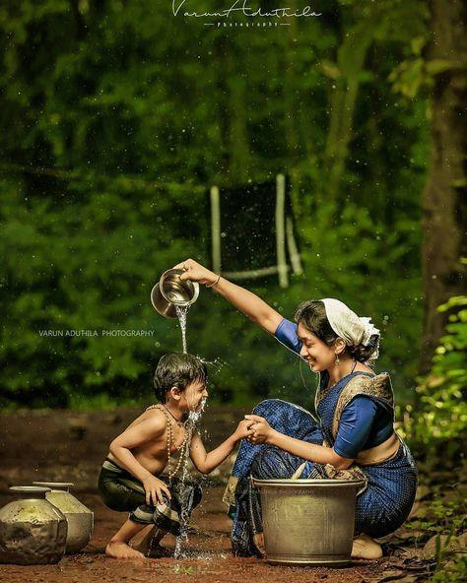
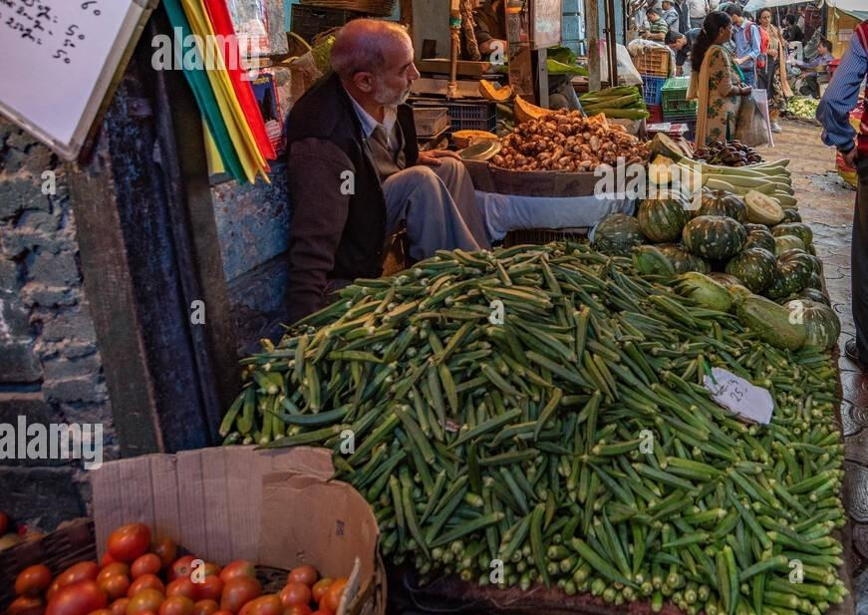
My Story
When I was a kid of 4 years. I lived in Delhi with my family. I was very naughty. One day, My mother and me went to khureji market near our home.
Khureji market

Slide 5

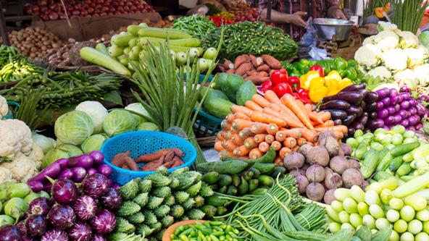
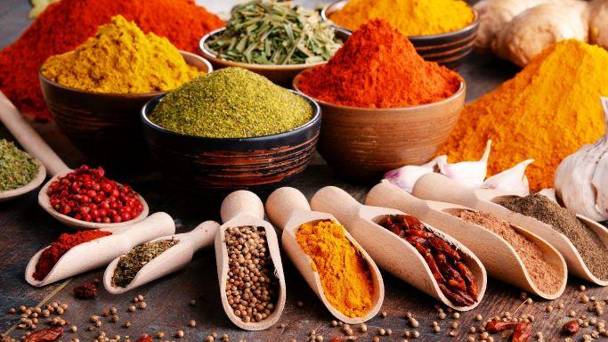
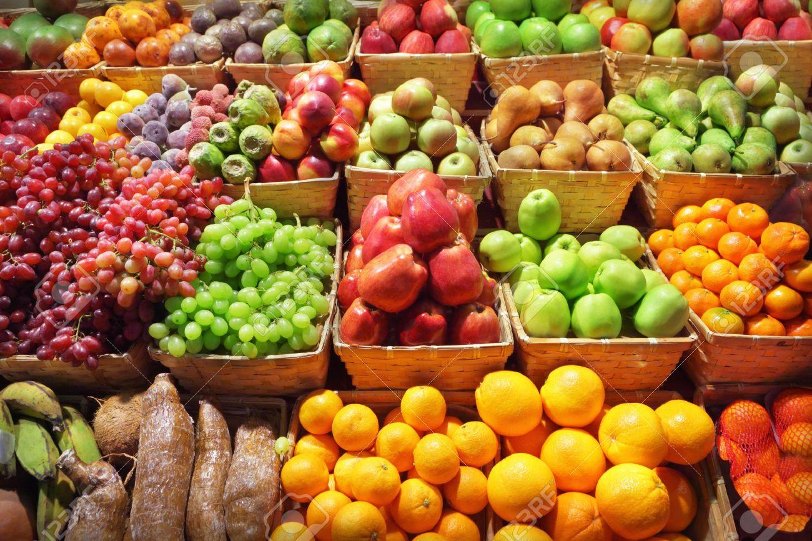
I have never seen so many fruits
and vegetables and spices before. I was enjoying and seeing many
veriety of fruits and vegetables

Slide 6
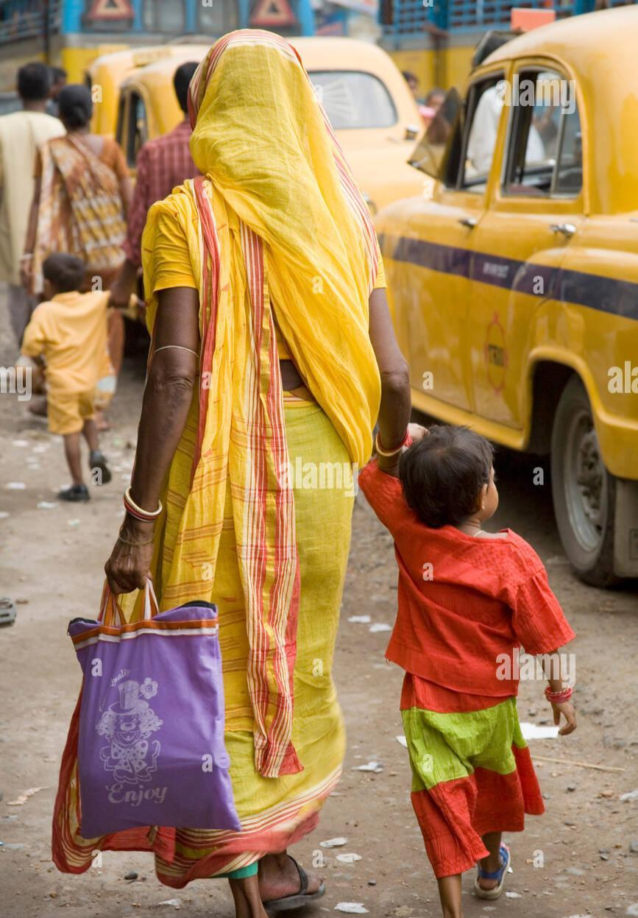
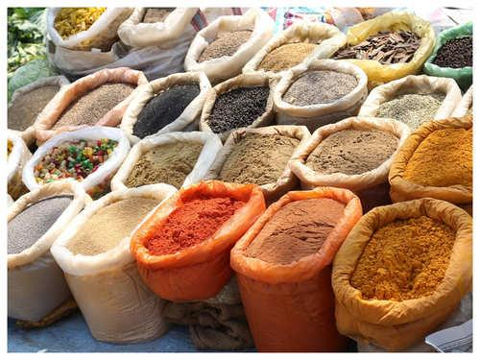
Then I started walking with my mother and reached a spice shop. My mother started looking at the Spices and I too but the spices were kept at a little height.

Slide 7
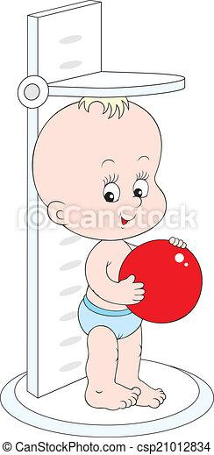
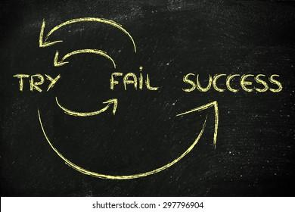
Due to my low height, I was not able to see the spices properly and I kept trying to see it by jump.

Slide 8
But that didn’t help and I fixed my brain and Then May started hanging from the box kept of spices. But the box full of red chillies fell on me and in my eyes I started crying and crying, that time was very painful for me. Then my mother quickly rubbed my eyes with soap and water, still I was in a lot of pain, then my mother took me to the nearby hospital.

Slide 9
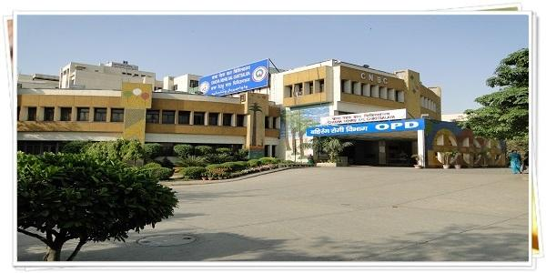

Slide 10
I was fine in two - three days. But I learnt from that moment that never leave child without safety at anywhere and everytime eyes on child. From then till today I do not like to go to the market. I understood by that moment that never do anything without permission or information. But I am risk taker so sometimes I like to do something without permission or knowledge.
By Raj
9209
SoSE Gandhi nagar

Slide 11


