Slide 1


Case Study
India Education Outcomes Fund
Archana Mehendale
Tata Institute of Social Sciences, Mumbai

Slide 2
Acknowledgments
Ashutosh Tyagi, Lead – Social Finance India and Partner – IEOF, Mumbai
Satyajit Salian, Lead – Education, Tata Trusts, Mumbai
Ajay Singh, Munaf Merchant, Shiva Thorat, Sayan B., Padma M. Sarangapani, Centre for Education Innovation and Action Research, Tata Institute of Social Sciences, Mumbai
NORRAG and SUDAC-COFER

Slide 3
OUTLINE
CONTEXT
THEORY OF CHANGE
APPROACH AND DESIGN
KEY ACTORS
LESSONS

Slide 4
CONTEXT

Slide 5
CONSIDERATIONS
1
EXPANDING PRIVATE SPENDING
2
CORPORATE SOCIAL RESPONSIBILITY
Annual private spend is USD 56 billion out of a total of USD 133 billion annual market of education in India - Kaizen (n.d.)
Statutory obligation on the corporate sector to spend 2% of their average net profits of 3 years for social causes - The Companies (Amendment) Act, 2014
3
LEARNING CRISIS
4
ATTRACTIVE MARKET FOR IMPACT INVESTING
Poor learning outcomes as per National Achievement Survey and Annual Status of Education Survey
Financial reports about stable financial markets, rule of law, recession proof sector, low working capital requirement, unmet social needs - Pandit & Tamhane (2017); Kaizen (n.d.)

Slide 6
CONSIDERATIONS
5
UNDER ALLOCATION OF FUNDS
6
MOBILIZATION OF DOMESTIC RESOURCES
Decline in foreign aid assistance due to economic growth and global positioning
3.4% of GDP (USD 63 billion) falls short of 6% target set aside by national policy and Education 2030
7
FUNDING GAP FOR ACHIEVING SDGs
8
EDUCATE GIRLS
Size of the gap: USD 740 billion (2015-2030) – Bhamra, Shanker & Niazi (2015)
Successful experience of the first DIB on education implemented in Rajasthan generated interest

Slide 7
SOCIAL FINANCE INDIA
To harness capital to address social challenges where outcomes are poor, where the system is acknowledged to be failing and where the costs of failure are high
Nonprofit established in 2018 in Mumbai, with financial support of Tata Trusts
India Education Outcomes Fund Prospectus 2019

Slide 8
SOCIAL FINANCE INDIA
INDIA EDUCATION OUTCOMES FUND (IEOF)
First Outcome Fund of its kind that aims to catalyze outcome-focused funding and work with funders, service providers and governments at scale

Slide 9
THEORY OF CHANGE

Slide 10
VISION
To create transformational impact in Indian education through funding USD 1 billion of outcomes-focused activity
India Education Outcomes Fund Prospectus 2019

Slide 11
THRUST AREAS
Early Childhood Education
Foundational Learning Skills
Secondary Learning
School to Workforce transition
Inclusive education (learning and intellectual disabilities)

Slide 12
OUTCOMES
Through a unique pay-for-success model, IEOF aims to focus on the following outcomes:
Catalyze funding across a variety of sources to scale proven impact aligned with national priorities
Outcome funder money will go further, through paying only for outcomes actually achieved
Bring private sector rigor and tools to manage social investments
Build an ecosystem of accountable service providers, investors, and funders able to work at scale
India Education Outcomes Fund Prospectus 2019

Slide 13
ADDRESS CURRENT PROBLEMS OF
PUBLIC EDUCATION BUDGET IS NOT ENOUGH TO MEET SDG 4
INSECURITY ABOUT FUNDING
GOVERNMENT FUNDS ARE RESTRICTED AND INPUT-BASED
NEED FLEXIBILITY TO INNOVATE AND SCALE
NEED FOR GREATER ACCOUNTABILITY

Slide 14
APPROACH AND DESIGN

Slide 15
Development Impact Bonds
Investor
Service Provider
1. Working capital
2. Program implementation
Beneficiaries
5. Results-based
payment
3. Independent
evaluation
6. Incentive payment
Outcome Payer
Outcome Evaluator
4. Report on outcomes

Slide 16
IMPACT BONDS V1.0 versus IMPACT BONDS AT SCALE
Funds for outcomes relatively small compared to contracting cost
Individual overheads associated with structuring impact bonds
High cost, bespoke M&E
Bespoke contracts ‘reinvent the wheel’
More standardized contracts, processes for efficiency
Larger pools of outcome funds per rate card
Pooled funds, commission multiple contracts using central expertise
Cost-effective evaluation, use technology and existing M&E frameworks

Slide 17
IEOF AS AN INTERMEDIARY
IEOF SETS OBJECTIVES IN CONSULTATION WITH ALL PARTIES
OUTCOME FUNDERS, RISK INVESTORS ASKED TO PLEDGE PAYMENTS
OUTCOME METRICS AND PAYMENT MECHANISM ARE SET
RISK INVESTOR PAYS UPFRONT AND PERFORMANCE MANAGER MONITORS RISK
SERVICE PROVIDERS ARE CHOSEN BASED ON BIDDING, CAPACITY AND DUE DILIGENCE
OUTCOMES VALIDATED BY ASSESSORS, IEOF PAYS RISK INVESTORS – PRINCIPAL, INTEREST, INCENTIVES FOR SERVICE PROVIDERS

Slide 18
KEY ACTORS

Slide 19
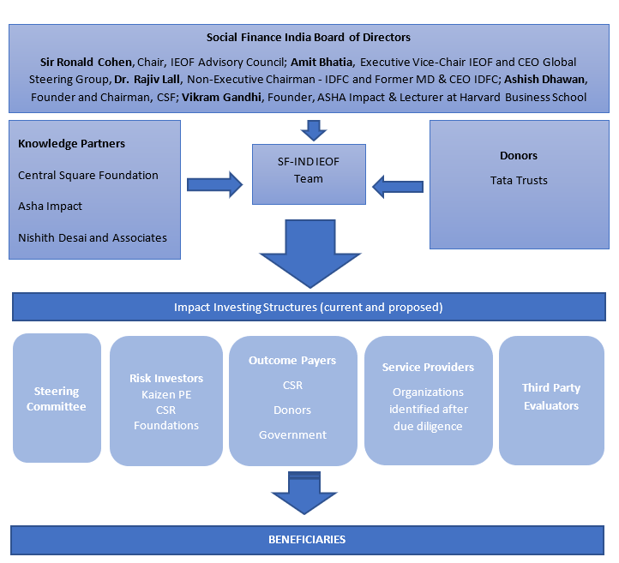
SIMPLE TEXT

Slide 20
LESSONS

Slide 21
INSIGHTS
SEGMENTATION OF THE SECTOR
SOME CHALLENGES ARE ‘DIB-ABLE’, SOME SERVICE PROVIDERS CAN ABSORB DIB FUNDING
INNOVATION WITHIN REGULATORY BOUNDARIES
REGULATORY RESTRICTIONS ACROSS DIFFERENT LEGISLATION
NECESSARY TO TAP UNCONVENTIONAL FUNDING
NEED TO GO BEYOND PHILANTHROPIC FUNDING AND TAP PRIVATE FUNDING AND GOVERNMENT FUNDING

Slide 22
A DELICATE BALANCING ACT
DYNAMIC BETWEEN RISK INVESTORS AND THE OUTCOME PAYERS
TARGET SETTING – NOT TO HIGH, NOT TOO LOW
SUPPORTING EXPERIMENTATION OR PROVEN INITIATIVES
SEARCH FOR THE SWEET SPOT, SCALING UP AS A RISK & INNOVATION
PREFERENCE FOR MEASURABILITY OF OUTCOMES
SUPPORTING WHAT CAN BE MEASURED AND WHAT IS REQUIRED

Slide 23
REFERENCES
Bhamra, A., Shanker, H., & Niazi, Z. (2015). Achieving the Sustainable Development Goals in India. A Study of Financial Requirements and Gaps. Technology and Action for Rural Advancement, A Social Enterprise of Development Alternatives Group. New Delhi, India: Devalt
Social Finance India, India Education Outcomes Fund and GSG (2019). India Education Outcomes Fund Prospectus. 2019.
EY and FICCI (2014). Private Sector’s Contribution to K-12 Education in India: Current impact, challenges and way forward. http://ficci.in/spdocument/20385/ey-ficci-report-education.pdf
Kaizen (n.d.). Understanding the Sector. Kaizen Education (KE) Report. Update 2.1. http://www.kaizenpe.com/kies2014/pdf/Kaizen-Education-Report.pdf
Nishith Desai Associates (2019). Impact Investing Simplified: A Guide to Making and Receiving Impact Investments in India. Nishith Desai Associates, Thomson Reuters Foundation and Aspen Network of Development Entrepreneurs. http://www.nishithdesai.com/fileadmin/user_upload/pdfs/Research%20Papers/IMPACT_INVESTING_SIMPLIFIED_IN_INDIA.pdf
Pandit, V. and Tamhane, T. (2017). Impact Investing: Purpose-driven Finance Finds its Place in India. Private Equity and Principal Investors Practice. McKinsey & Company. https://thegiin.org/assets/Impact-investing-finds-its-place-in-India.pdf

Slide 24
Thank you

