Slide 1

State of Teachers, Teaching and Teacher Education Report-2023
Review 1- Editorial Board meeting- 05-01-2023

Slide 2
Introduction and Background
The State of the Education Report for India 2021, ‘No Teacher, No Class’, identifies over one million teacher vacancies across different states. Teacher shortage is a challenge that affects the quality of education
Teacher recruitment, deployment and distribution are complex parameters that are not adequately reported in available data
There are different teacher education programs that prepares teachers, however the number of professionally qualified teachers as per RTE norms and the availability of subject teachers is inadequate

Slide 3
Introduction and Background (contd…)
The supply and demand of teachers pose various challenges such as: teacher preparation,recruiting teachers with requisite qualifications across different subjects and levels, estimating the need, deployment of teachers in different types of schools, addressing concerns of equity and justice through the allocation and distribution of teachers in underserved areas, and so on (UNESCO, 2021; OECD, 2012)
There are challenges specific to the Indian context such as regional differences in education performance, increasing privatisation of schooling, feminisation of teachers which exacerbates the inequalities

Slide 4
Introduction and Background (contd…)
This study focuses on the question of the demand and supply of teachers (of both private and government schools), and teacher availability in schools and attempts to provide suggestions for teacher recruitment and deployment
Notes:
Understand the interstate variations and explain the same

Slide 5
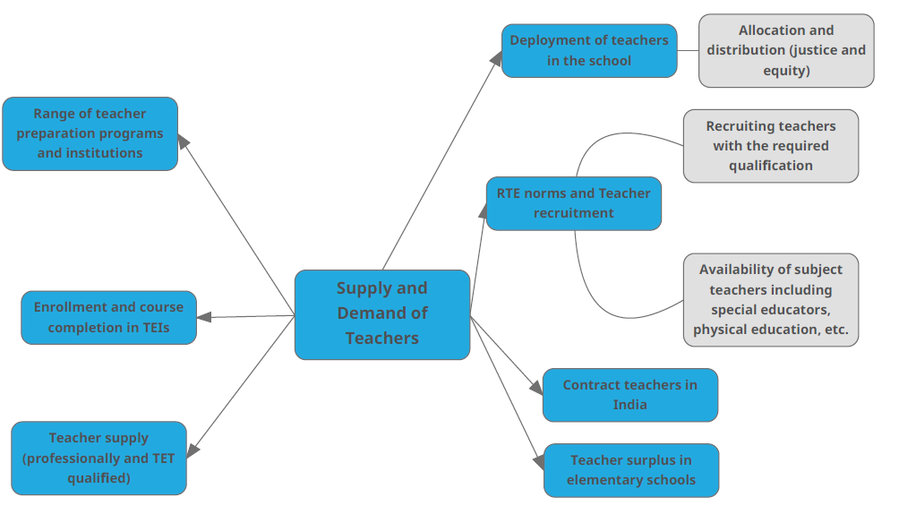
Background (contd…)

Slide 6
Research Questions
This study aims to address the supply and demand of teachers and focus on the recruitment and deployment of teachers for comprehensive planning and forecasting of teacher vacancies through the following questions:
1) What is the supply of professionally qualified including subject and school levels of teachers?
2) What and where is the demand for qualified teachers?
3) How do the supply and demand vary based on different factors?
4) How are RTE norms concerning teacher recruitment being fulfilled?
5) What is the quality of teacher supply?
Notes:
Various Factors- such as the size of the state, region (rural/urban), subjects (all school subjects including arts, physical education, special education, computer science, work education), levels (early years, primary and secondary), school management and gender?

Slide 7
Secondary Sources of Data
Understand nationwide trends, and inter-state variations with respect to:
Characteristics of education systems in states, including teacher availability, subject-wise PTR, student learning, NAS
Correlation between overall demography, geography and overall development of states, and education indicators
Growth of teacher education institutions
Recruitment, deployment, and transfer of teachers

Slide 8
Secondary Sources of Data
Key areas of data collection:
Teacher supply:
  Profile of existing teachers, existing vacancies and surplus, teacher recruitment and deployment
  Teacher education institutions (range of institutions and programs offered, enrollment and completion rates)
  Number of qualified teachers in various subject areas and number of TET qualified teachers
Teacher demand:
  Projection based on population/school enrollment, deployment, retirement, demand and supply ratio/correlation, teacher education and recruitment budgets
Sources of data:
  UDISE+, PLFS, AISHE databases, NAS
  PAB and PIB minutes
  NCTE
  Policy documents

Slide 9
Secondary Sources of Data
Key areas of need:
Subject-wise availability of teachers and subject PTR
Subject-wise vacancies
Recruitment policies, numbers and budgets for select states
Contract teachers regularisation
Enrollment and completion in teacher education institutions in select states, including specialisations
Number of TET qualified teachers in select states

Slide 10
Primary Data Collection Plan
Units
Teacher Educators
Government and Private Schools
Government Functionaries
What do we want to understand from Primary Data?
Teachers availability at school Level (adequacy of subject teachers, special educators)
Deployment of teachers
Who is coming to TEIs- what are the opportunities and aspirations?
Placement/Recruitment of the student-teachers
Student-teacher language proficiency and link to the demography
Notes:
what is the primary data collection for- what is it going to ?

Slide 11
Primary Data Collection Plan
And one urban district of capital of each State
India
Assam
Chhattisgarh
Jharkhand
Karnataka
Maharashtra
Darrang
Dhubri
Korba
Sukma
Pakur
Ramgarh
Raichur
Yadgir
Nandurbar
Gadchiroli
Meghalaya
Odisha
Punjab
Telangana
Ribhoi
Dhenkanal
Nabarangpur
Moga
Firozpur
Bhoopalapally
Bhadradri

Slide 12
Primary Data Collection Plan
Interviews with
Teacher Educators
Student-Teachers
District Education Officer
Head Teachers and Teachers
University Dean/Director/Chairperson- Department of Education
Case Studies of
Selected government schools
Selected private B.Ed colleges and DIETs
A private school network

Slide 13
Timelines and Way Forward
Nov 22 – Jan 23
Feb – Mar 23
April – June 23
July – Sept 23
  Finalise concept note
  Preliminary mapping of data sources: secondary and primary
  Editorial Board Meeting - 1
  Primary data collection preparation
  Primary data collection
  Secondary data analysis
  Editorial Board Meeting - 2
  Data processing, analysis and interpretation
  Report writing
  Editorial Board meeting – 3
  Report writing
  Sharing early findings and recommendations
  Final report launched on Sept 5

Slide 14
Thank You

